Slide 1


Analyzing and Leveraging Shared L1 Caches in GPUs
Mohamed Assem Ibrahim, Onur Kayiran, Yasuko Eckert, Gabriel H. Loh, Adwait Jog

Slide 2
State of GPU Computing
GPU Scaling Trends
GPU die sizes are getting larger
Core count is increasing as well
Wikipedia (Data)

Slide 3
State of GPU Computing
Challenges with Large-Scale GPUs
Private
L1
2 Replication of data (cache line) across L1 caches
Core
Core
Core
Core
Core
Core
Core
Core
Core
Core
Core
Core
L1
L1
L1
L1
L1
L1
L1
L1
L1
L1
L1
L1
Network-on-Chip (NoC)
Reply
1 L1 bandwidth is underutilized
& L2 bandwidth is a bottleneck!
L2
L2
L2
L2
L2
Memory
Memory
Memory
Memory

Slide 4













Let's Bake Cookies!
PACT 2019
Ingredients:
  Peanut Butter
  Sugar
  Eggs
  Chocolate Chips
Neighbors = Additional Source of Ingredients!
Images/Icons from commons.wikimedia.org, creazilla.com, and flaticon.com

Slide 5
Let's Bake Cookies!
Ingredients:
  Peanut Butter
  Sugar
  Eggs
  Chocolate Chips
Agree that each one of us will buy and keep one type only!
No Replication = Additional Ingredients in the Building!
Images/Icons from commons.wikimedia.org, creazilla.com, and flaticon.com

Slide 6
Goal & Contributions
Challenge & Contributions:
  Data replication (associated with GPUs’ private L1 caches) reduces the effective aggregate L1 cache capacity across all cores
  Shared L1 caches in GPUs significantly improve the collective L1 hit rates and reduce the bandwidth pressure on L2 caches
  A lightweight dynamic scheme to reconfigure the L1 caches as shared or private based on the application’s behavior
Results:
  Improve IPC by 22% (up to 52%) and energy efficiency by 49%
  Have a modest hardware overhead of 0.09 mm² per core

Slide 7
Outline
Introduction
Motivation
Enabling Shared L1 Caches
Evaluation
Conclusions

Slide 8
Private L1 Caches
Replication of L1 Data across Cores
Full Addr.
Range
Full Addr.
Range
Full Addr.
Range
Full Addr.
Range
Full Addr.
Range
Full Addr.
Range
Full Addr.
Range
Full Addr.
Range
Full Addr.
Range
Full Addr.
Range
Full Addr.
Range
Full Addr.
Range
Core
Core
Core
Core
Core
Core
Core
Core
Core
Core
Core
Core
L1
L1
L1
L1
L1
L1
L1
L1
L1
L1
L1
L1
Network-on-Chip
L2
L2
L2
L2
L2
Memory
Memory
Memory
Memory

Slide 9
Shared L1 Caches
Replication Eliminated!
Addr.
Range A₀
Addr.
Range A₁
Addr.
Range A₂
Addr.
Range A₃
…
…
…
…
…
…
Addr.
Range A_{n-2}
Addr.
Range A_{n-1}
Unique Addr. Range Slice
Core
Core
Core
Core
Core
Core
Core
Core
Core
Core
Core
Core
L1
L1
L1
L1
L1
L1
L1
L1
L1
L1
L1
L1
Req.
Core
Home
Core
Do not Cache!
Network-on-Chip
Request
Reply
L2
L2
L2
L2
L2
Memory
Memory
Memory
Memory

Slide 10
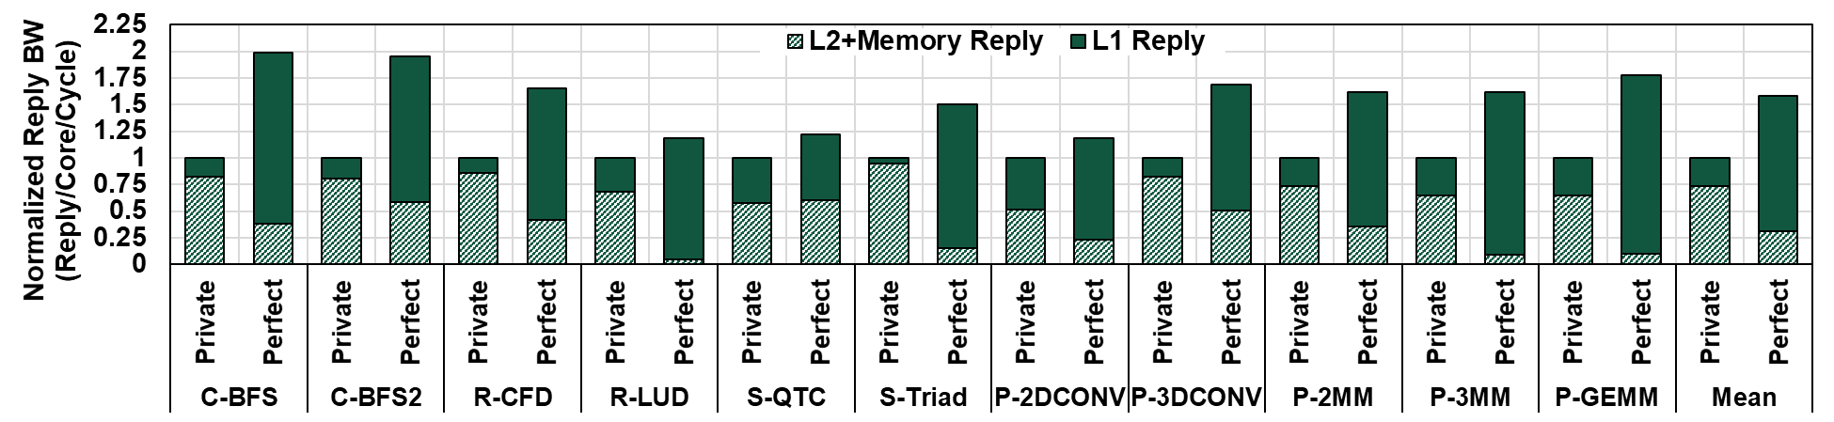
Shared L1 Caches
Performance Scope
Zero-cycle Communication
Additional bandwidth from eliminating replication
  More Capacity → More Cached Data → Higher Hit Rate → More Bandwidth
This additional bandwidth is correlated with IPC
  IPC increases (up to 84%)

Slide 11
Outline
Introduction
Motivation
Enabling Shared L1 Caches
Evaluation
Conclusions

Slide 12
Inter-core Communication
Core (CU or SM)
L2+Memory
2D Mesh
  Inherent core-to-core communication
  Under-utilized links
Work Distribution Crossbar
  Used in the graphics pipeline
More information in the paper!

Slide 13
Shared L1 Caches
Solution?
5%
Drop
80%
Drop
Eliminate Replication → Lower L1 Miss Rate
Performance drops by 5%!
Naïve Communication → 2.2X Latency Overhead

Slide 14
Optimized Shared L1 Caches
Reduce Wasted NoC Bandwidth
32B | 32B | 32B | 32B
Cache Line
Chunking
Reply from Home only has requested data by the Requester

Slide 15
Optimized Shared L1 Caches
Shared++
Replication-insensitive
Applications?
26%
77%
Drop
Eliminate Replication → Lower L1 Miss Rate
Performance improves by 26%!
Optimized Communication → 9% Latency Overhead

Slide 16
Handling Private-friendly Applications
Sampling Phase
Execution Phase
Collect counters
Check end of phase
Evaluate metrics
Choose Shared or Private cache organization
Execute with chosen organization
Check end of phase

Slide 17
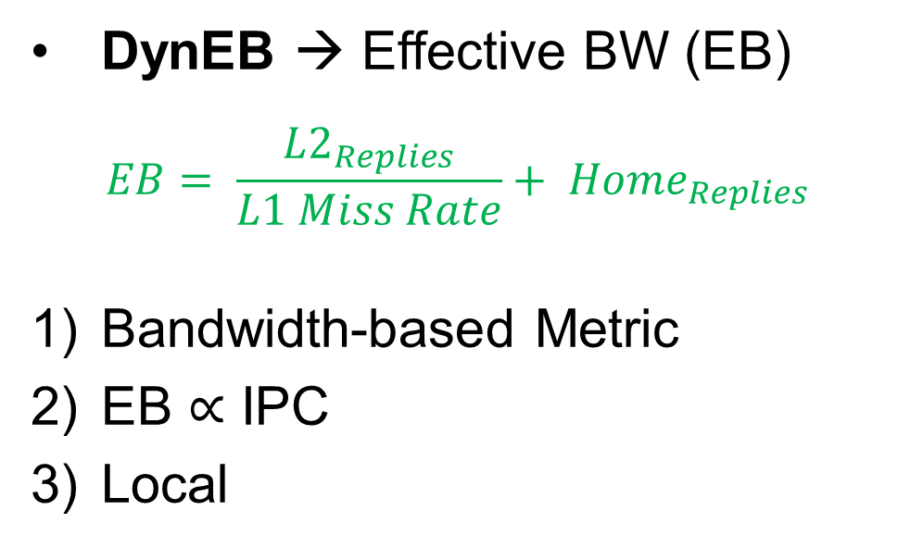
Handling Private-friendly Applications
Sampling Phase
Set
Legend
Request Address
Sets treated as Private
LSB of Set bits
Sets treated as Shared
DynEB → Effective BW (EB)
$$EB= \frac{{L2}_{Replies}}{L1 Miss Rate}+ {Home}_{Replies}$$
Bandwidth-based Metric
EB $∝$ IPC
Local
Core
L1 Cache
Even
0?
Odd
Set 0
Set 1
Set 2
Set 3
Set 4
Set 5
. .
Set 30
Set 31
Private Stats
Shared Stats
Local L1 Requests
Local L1 Requests
L1 Requests
L1 Requests
Counters
L1 Misses
Counters
L1 Misses
Replies from L2
Replies from L2
Replies from Homes
Replies from Homes
Sampling
Completed?
Evaluate Sampling Stats
Private or Shared
Yes
Wang, et al. “Efficient and Fair Multi-programming in GPUs via Effective Bandwidth Management.” HPCA’18.

Slide 18
Outline
Introduction
Motivation
Enabling Shared L1 Caches
Evaluation
Conclusions

Slide 19
Evaluation
IPC
More results in the paper!
Replication-sensitive
Private-friendly
22%
Results are normalized to Private L1 organization baseline
Replication-sensitive Applications → Average = +22%, Max = +52%
Private-friendly Applications → Average = -4%

Slide 20
Conclusions
Observe an opportunity for shared L1 caches in GPUs to eliminate/reduce data replication across the L1 caches and improve the GPU performance
Address the challenges associated with shared L1 caches
  Develop GPU-specific optimizations to reduce inter-core communication overheads
  Develop a dynamic scheme that classifies application phases and reconfigures the L1 caches as shared or private accordingly
Results
  22% IPC improvement for the replication-sensitive applications
  4% IPC degradation for the private-friendly applications
  Modest area overhead of 0.09 mm² per core (determined by detailed RTL synthesis)

Slide 21
Disclaimer & Attribution
The information presented in this document is for informational purposes only and may contain technical inaccuracies, omissions and typographical errors.
The information contained herein is subject to change and may be rendered inaccurate for many reasons, including but not limited to product and roadmap changes, component and motherboard version changes, new model and/or product releases, product differences between differing manufacturers, software changes, BIOS flashes, firmware upgrades, or the like. AMD assumes no obligation to update or otherwise correct or revise this information. However, AMD reserves the right to revise this information and to make changes from time to time to the content hereof without obligation of AMD to notify any person of such revisions or changes.
AMD MAKES NO REPRESENTATIONS OR WARRANTIES WITH RESPECT TO THE CONTENTS HEREOF AND ASSUMES NO RESPONSIBILITY FOR ANY INACCURACIES, ERRORS OR OMISSIONS THAT MAY APPEAR IN THIS INFORMATION.
AMD SPECIFICALLY DISCLAIMS ANY IMPLIED WARRANTIES OF MERCHANTABILITY OR FITNESS FOR ANY PARTICULAR PURPOSE. IN NO EVENT WILL AMD BE LIABLE TO ANY PERSON FOR ANY DIRECT, INDIRECT, SPECIAL OR OTHER CONSEQUENTIAL DAMAGES ARISING FROM THE USE OF ANY INFORMATION CONTAINED HEREIN, EVEN IF AMD IS EXPRESSLY ADVISED OF THE POSSIBILITY OF SUCH DAMAGES.
ATTRIBUTION
© 2020 Advanced Micro Devices, Inc. All rights reserved. AMD, the AMD Arrow logo and combinations thereof are trademarks of Advanced Micro Devices, Inc. in the United States and/or other jurisdictions. Other names are for informational purposes only and may be trademarks of their respective owners.

Slide 22
* We acknowledge the support of the National Science Foundation (NSF) CAREER award #1750667.
* This presentation and recording belong to the authors. No distribution is allowed without the authors' permission.
Thank You!
Questions?
Mohamed Assem Ibrahim
https://massemibrahim.github.io/

