Slide 1

RCoal: Mitigating GPU Timing Attack via Subwarp-based Randomized Coalescing Techniques
Gurunath Kadam (College of William and Mary)
Danfeng Zhang (Penn State University)
Adwait Jog (College of William and Mary)

Slide 2








Correlation Timing Attacks
Server
Plaintexts | Ciphertexts | Time duration
Plaintext # 1
Ciphertext # 1
time₁
Plaintext # 2
Ciphertext # 2
time₂
Plaintext # 3
Ciphertext # 3
time₃
…
…
…
Correct Key??
Correct Key
K₁ , K₂ , … ,
, …
K_{i}
Attacker
time_{start}
- time_{stop} = time₁
Key guesses
Notes:
This should be a general timing attack description

Slide 3
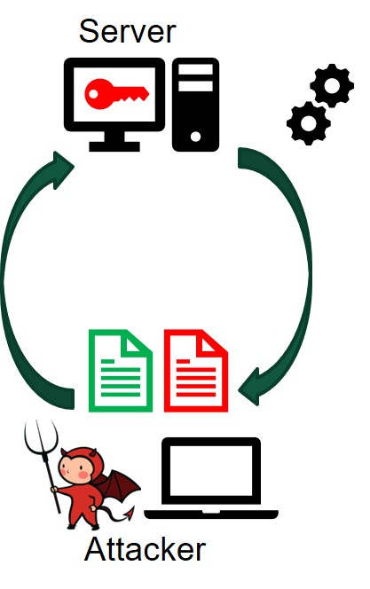
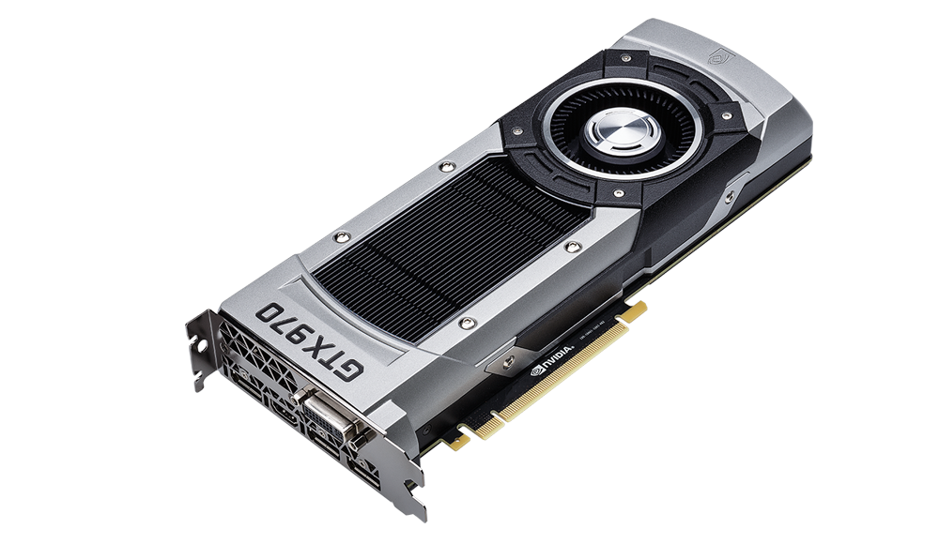
Correlation Timing Attacks
GPU
GPUs implement SIMD paradigm
Fast and energy efficient computations
Accelerate the cryptographic algorithms
Are GPUs vulnerable to Correlation Timing Attacks?
Notes:
Highlight the GPU – Make bigger put block
Highlight the importance of GPU in words

Slide 4
Executive summary
Prior Work: Correlation Timing Attacks on GPUs ([Jiang/Fei/Kaeli, HPCA’16])
  Key idea: Last round memory accesses can be determined using AES key.
  Memory accesses are coalesced together deterministically by GPUs and hence can be calculated correctly by an attacker.
  Number of coalesced memory accesses correlates with the execution time.
  Attacker can recover AES key by correlating the execution time and the calculated coalesced accesses.
Our Contribution: Randomizing the Coalescing Mechanism (RCoal)
  Goal: Make the calculation of coalesced accesses harder for the attacker.
  Our proposal: Three novel coalescing mechanisms that randomize the size, number, and thread-elements of a sub-warp.
  Results: RCoal improves security by 24- to 961- times at a modest performance loss of 5 to 28%.
Notes:
In to two slides – show successful and unsuccessful correlation plots

Slide 5
Outline
Introduction
Background
  Memory Access Coalescing in GPU
  Baseline Correlation Timing Attack on GPU

Slide 6
Outline
Introduction
Background
RCoal Security Schemes
Evaluation
Conclusions

Slide 7
Outline
Introduction
Background
RCoal Security Schemes
Evaluation
Conclusions

Slide 8
Outline
Introduction
Background
  Memory Access Coalescing in GPU
  Baseline Correlation Timing Attack on GPU
RCoal Security Schemes
Evaluation
Conclusion

Slide 9
Memory Access Coalescing in GPUs
Streaming Multiprocessor
Warp pool
Warp
Thread # 1
. . .
Thread # 32
Warp Scheduler
LD/ST Unit
Coalescing Unit
Global Memory

Slide 10
Memory Access Coalescing in GPUs
WARP
sid = subwarp id
tid = thread id
sid = 0
sid = 0
sid = 0
sid = 0
tid = 0
tid = 1
tid = 2
tid = 3
0x00
0x04
0x07
0x09
Block Address # 0
0x00
0x01
0x02
0x03
Block Address # 1
0x04
0x05
0x06
0x07
Block Address # 1
0x04
0x05
0x06
0x07
Block Address # 2
0x08
0x09
0x0A
0x0B

Slide 11
Memory Access Coalescing in GPUs
WARP
sid = subwarp id
tid = thread id
sid = 0
sid = 0
sid = 0
sid = 0
tid = 0
tid = 1
tid = 2
tid = 3
0x00
0x04
0x07
0x09
SUBWARP
Coalescing Unit
Block Address # 0
0x00
0x01
0x02
0x03
Block Address # 1
0x04
0x05
0x06
0x07
Block Address # 2
0x08
0x09
0x0A
0x0B

Slide 12
Outline
Introduction
Background
  Memory Access Coalescing in GPU
  Baseline Correlation Timing Attack on GPU
RCoal Security Schemes
Evaluation
Conclusion

Slide 13
AES implementation on GPU
Symmetric Encryption with 128-bit key and 10 rounds.
S-box implementation involves table lookups.
[Jiang/Fei/Kaeli, HPCA’16] demonstrated that the last round is vulnerable.

Slide 14
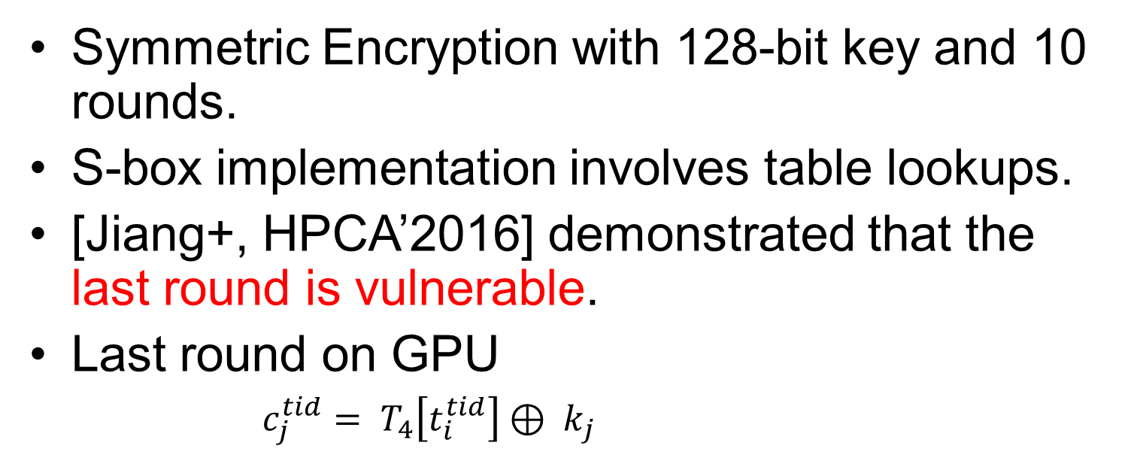
AES implementation on GPU
Symmetric Encryption with 128-bit key and 10 rounds.
S-box implementation involves table lookups.
[Jiang+, HPCA’2016] demonstrated that the last round is vulnerable.
Last round on GPU
    $c_{j}^{tid}= T_{4}\left[t_{i}^{tid}\right]⊕ k_{j}$
c_{j} | = j^{th} column of the ciphertext (output of the round)
tid | = thread id
t_{i} | = i^{th} column of the input text to the last round (input to the round)
k_{j} | = j^{th} key byte of AES key
T₄[] | = Table look-up operation (generates memory access)

Slide 15

AES implementation on GPU
AES Key
j^{th} key byte
Last round on GPU
59 fc e4 34 18 b7 84 61 1a 96 15 5e 36 b8 49 32
$$c_{j}^{tid}= T_{4}[t_{i}^{tid}] ⊕ k_{j}$$
c7 58 ee 66 57 29 af ab 8b fd 76 4e e7 5b df 05
f7 92 2f b7 a6 01 6a 5c 2c b7 72 87 77 60 cd e8
. . .
2e 7d bb 49 22 58 22 cd 3d 19 0b ec 64 a6 a9 d4
bb 17 89 88 4f d2 a8 9f 1b 7a 4d c4 c8 73 27 c6
. . .
1d 84 26 a6 bd 41 f1 b3 5e bc 50 21 e1 4c c3 79
91 9b a7 58 b2 46 a1 b0 e6 b3 01 b5 14 cd 10 d9
c_{j}^{tid} = j^{th} column of ciphertext
tid = thread id
Input to the last round
i^{th} column

Slide 16

AES implementation on GPU
j^{th} key byte
AES Key
59 fc e4 34 18 b7 84 61 1a 96 15 5e 36 b8 49 32
Last round on GPU
i^{th} column
$$c_{j}^{tid}= T_{4}[t_{i}^{tid}] ⊕ k_{j}$$
c7 58 ee 66 57 29 af ab 8b fd 76 4e e7 5b df 05
f7 92 2f b7 a6 01 6a 5c 2c b7 72 87 77 60 cd e8
. . .
2e 7d bb 49 22 58 22 cd 3d 19 0b ec 64 a6 a9 d4
bb 17 89 88 4f d2 a8 9f 1b 7a 4d c4 c8 73 27 c6
. . .
1d 84 26 a6 bd 41 f1 b3 5e bc 50 21 e1 4c c3 79
91 9b a7 58 b2 46 a1 b0 e6 b3 01 b5 14 cd 10 d9
Input to the last round

Slide 17

Last Round of AES on GPU
$c_{j}^{tid}= T_{4}[t_{i}^{tid}] ⊕ k_{j}$

Slide 18
Last Round of AES on GPU
$c_{j}^{tid}= T_{4}[t_{i}^{tid}] ⊕ k_{j}$
t_{i}¹
Thread # 1
T₄[t_{i}¹]
Request # 1
Replies # 1
⊕ k_{j}
c_{j}¹
LINE # 1
LINE # 2
Thread # 2
T₄[t_{i}²]
Request # 2
Replies # 2
⊕ k_{j}
t_{i}²
c_{j}²
.
.
.
.
.
.
.
.
.
.
.
.
.
.
.
.
.
.
.
.
.
.
.
.
…
…
Coalescing
Unit
…
…
t_{i}³²
Thread # 32
T₄[t_{i}³²]
Request # 32
Replies # 32
⊕ k_{j}
LINE # 32
c_{j}³²
Input text
to Last Round
Ciphertext

Slide 19
Outline
Introduction
Background
  Memory Access Coalescing in GPU
  AES implementation on GPU
  Correlation Timing Attack on GPU
RCoal Security Schemes
Evaluation
Conclusion

Slide 20
Correlation Timing Attack on GPU [Jiang+, HPCA’16]
Goal of the attack: Recover all 16 bytes of the AES Key
Server
Plaintexts | Ciphertexts | Time duration
Plaintext # 1
Ciphertext # 1
Execution time₁
Plaintext # 2
Ciphertext # 2
Execution time₂
Plaintext # 3
Ciphertext # 3
Execution time₃
…
…
…
Attacker
Notes:
After the goal, Attack model – using figure slide 2. What is available to the attacker – ciphertext, execution time and AES Tables.

Slide 21


Correlation Timing Attack on GPU
Goal of the attack: Recover all 16 bytes of the AES Key
Last Round of AES is vulnerable
Last Round is invertible
Attacker can find number of coalesced accesses per warp
$$c_{j}^{tid}= T_{4}[t_{i}^{tid}] ⊕ k_{j}$$
Memory access
of thread tid
$t_{i}^{tid}= T_{4}^{−1}[c_{j}^{tid} ⊕k_{j}]$
Associate the number of coalesced accesses with execution time
Notes:
After the goal, Attack model – using figure slide 2. What is available to the attacker – ciphertext, execution time and AES Tables.

Slide 22
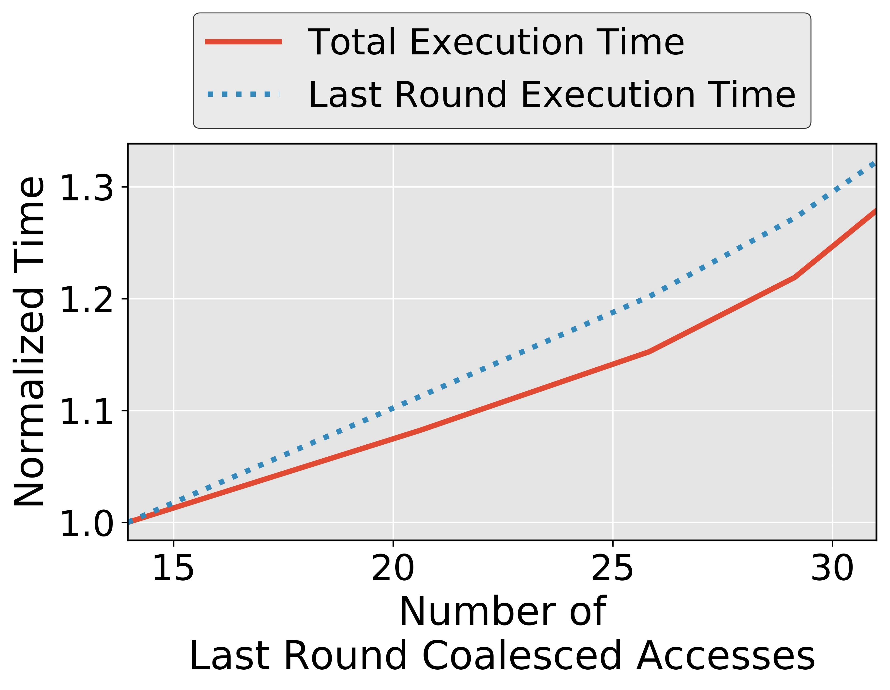
Coalesced Accesses and Execution Time
How an attacker can calculate the number of coalesced accesses?
Notes:
Say on our set-up

Slide 23


Calculation of number of coalesced accesses
Last Round of AES
Invertible
$$c_{j}^{tid}= T_{4}[t_{i}^{tid}] ⊕ k_{j}$$
Memory access
of thread tid
$t_{i}^{tid}= T_{4}^{−1}[c_{j}^{tid} ⊕k_{j}]$

Slide 24

Calculation of number of coalesced accesses
$t_{i}^{tid}= T_{4}^{−1}[c_{j}^{tid} ⊕k_{j}]$
Guessed Table
Lookup Indices
c_{j}¹
⊕ k_{j}^{m}
T₄⁻¹[c_{j}¹⊕k_{j}^{m}]
t_{i}^{1,m}
c_{j}²
⊕ k_{j}^{m}
T₄⁻¹[c_{j}²⊕k_{j}^{m}]
t_{i}^{2,m}
Correct value of key byte?
.
.
.
.
.
.
.
.
.
.
.
.
.
.
.
.
.
.
.
.
.
…
…
Coalesced Accesses
(A_{j}^{m,n})
c_{j}³²
⊕ k_{j}^{m}
T₄⁻¹[c_{j}³²⊕k_{j}^{m}]
t_{i}^{32,m}
Ciphertext

Slide 25
Calculation of number of coalesced accesses
$t_{i}^{tid}= T_{4}^{−1}[c_{j}^{tid} ⊕k_{j}]$
Guessed Table
Lookup Indices
Thread # 1
c_{j}¹
⊕ k_{j}^{m}
T₄⁻¹[c_{j}¹⊕k_{j}^{m}]
t_{i}^{1,m}
Thread # 2
c_{j}²
⊕ k_{j}^{m}
T₄⁻¹[c_{j}²⊕k_{j}^{m}]
t_{i}^{2,m}
Correct value of key byte?
.
.
.
.
.
.
.
.
.
.
.
.
.
.
.
.
.
.
.
.
.
.
.
.
…
…
Coalesced Accesses
(A_{j}^{m,n})
Thread # 32
c_{j}³²
⊕ k_{j}^{m}
T₄⁻¹[c_{j}³²⊕k_{j}^{m}]
t_{i}^{32,m}
Ciphertext

Slide 26
Finding the Correct Key Value
Attacker encrypts ‘N’ number of plaintexts over server
  Records Ciphertext and Execution time
Recorded
Execution Time
# of Coalesced Accesses
Correlations
Key Guess 0
A_{j}^{0,1}, A_{j}^{0,2}, . . . . , A_{j}^{0,N}
E₁,E₂,...,E_{N}
Corr_{j}⁰
Key Guess 1
A_{j}^{1,1}, A_{j}^{1,2}, . . . . , A_{j}^{1,N}
Corr_{j}¹
.
.
.
.
.
.
Correct
Key Byte
Maximum
Correlation
Key
Guess α
A_{j}^{α,1}, A_{j}^{α,2}, . . . . , A_{j}^{α,N}
Corr_{j}^{α}
.
.
.
.
.
.
Key
Guess 255
A_{j}^{255,1}, A_{j}^{255,2}, . . . . ,A_{j}^{255,N}
Corr_{j}²⁵⁵
Notes:
Eliminate the slide transition

Slide 27
Finding the Correct Key Value
Attacker encrypts ‘N’ number of plaintexts over server
  Records Ciphertext and Execution time
Recorded
Execution Time
# of Coalesced Accesses
Correlations
Key Guess 0
A_{j}^{0,1}, A_{j}^{0,2}, . . . . , A_{j}^{0,N}
E₁,E₂,...,E_{N}
Corr_{j}⁰
Key Guess 1
A_{j}^{1,1}, A_{j}^{1,2}, . . . . , A_{j}^{1,N}
Corr_{j}¹
.
.
.
.
.
.
Correct
Key Byte
Maximum
Correlation
Key
Guess α
A_{j}^{α,1}, A_{j}^{α,2}, . . . . , A_{j}^{α,N}
Corr_{j}^{α}
.
.
.
.
.
.
Key
Guess 255
A_{j}^{255,1}, A_{j}^{255,2}, . . . . ,A_{j}^{255,N}
Corr_{j}²⁵⁵
Notes:
Eliminate the slide transition

Slide 28
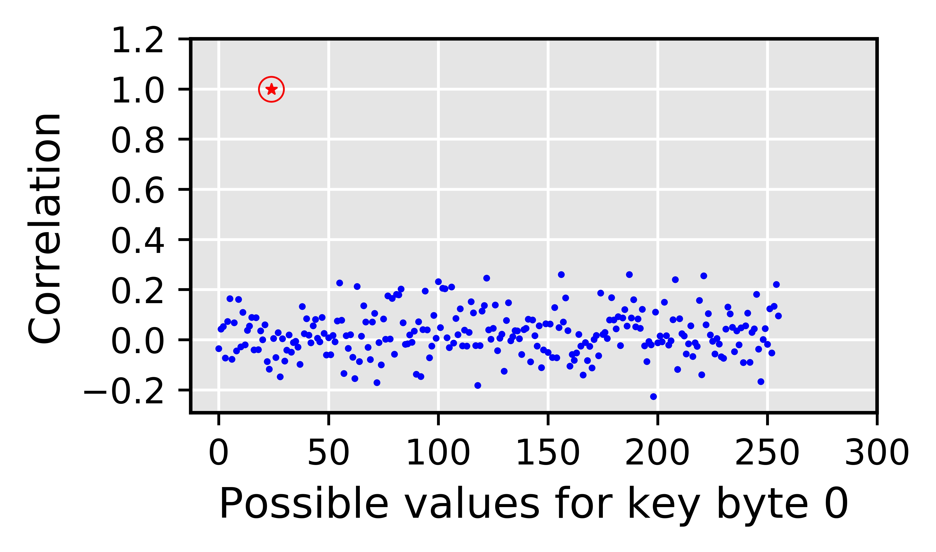
Simulating Timing Attack on our Set-up
Why is Correlation Timing Attack possible?
The baseline attack leverages the deterministic nature of the coalescing mechanism
  Fixed number of subwarps, number of subwarps = 1
  Fixed sizes of subwarp, size of subwarp = 32
  Deterministic mapping of the thread elements to subwarps
How to mitigate Correlation Timing Attacks on GPU?
Correct guess
Incorrect guesses
Notes:
TODO: Coalescing good for performance and bad for security

Slide 29
Why is Correlation Timing Attack possible?
The baseline attack leverages the deterministic nature of the coalescing mechanism
  Fixed number of subwarps, number of subwarps = 1
  Fixed sizes of subwarp, size of subwarp = 32
  Deterministic mapping of the thread elements to subwarps
Defense mechanisms?

Slide 30
Outline
Introduction
Background
RCoal Security Schemes
  Naïve Solution
  Fixed Sized Subwarp (FSS)
  Random Sized Subwarp (RSS)
  Random Threaded Subwarp (RTS)
Evaluation
Conclusion

Slide 31
Outline
Introduction
Background
RCoal Security Schemes
  Naïve Solution
  Fixed Sized Subwarp (FSS)
  Random Sized Subwarp (RSS)
  Random Threaded Subwarp (RTS)
Evaluation
Conclusion

Slide 32
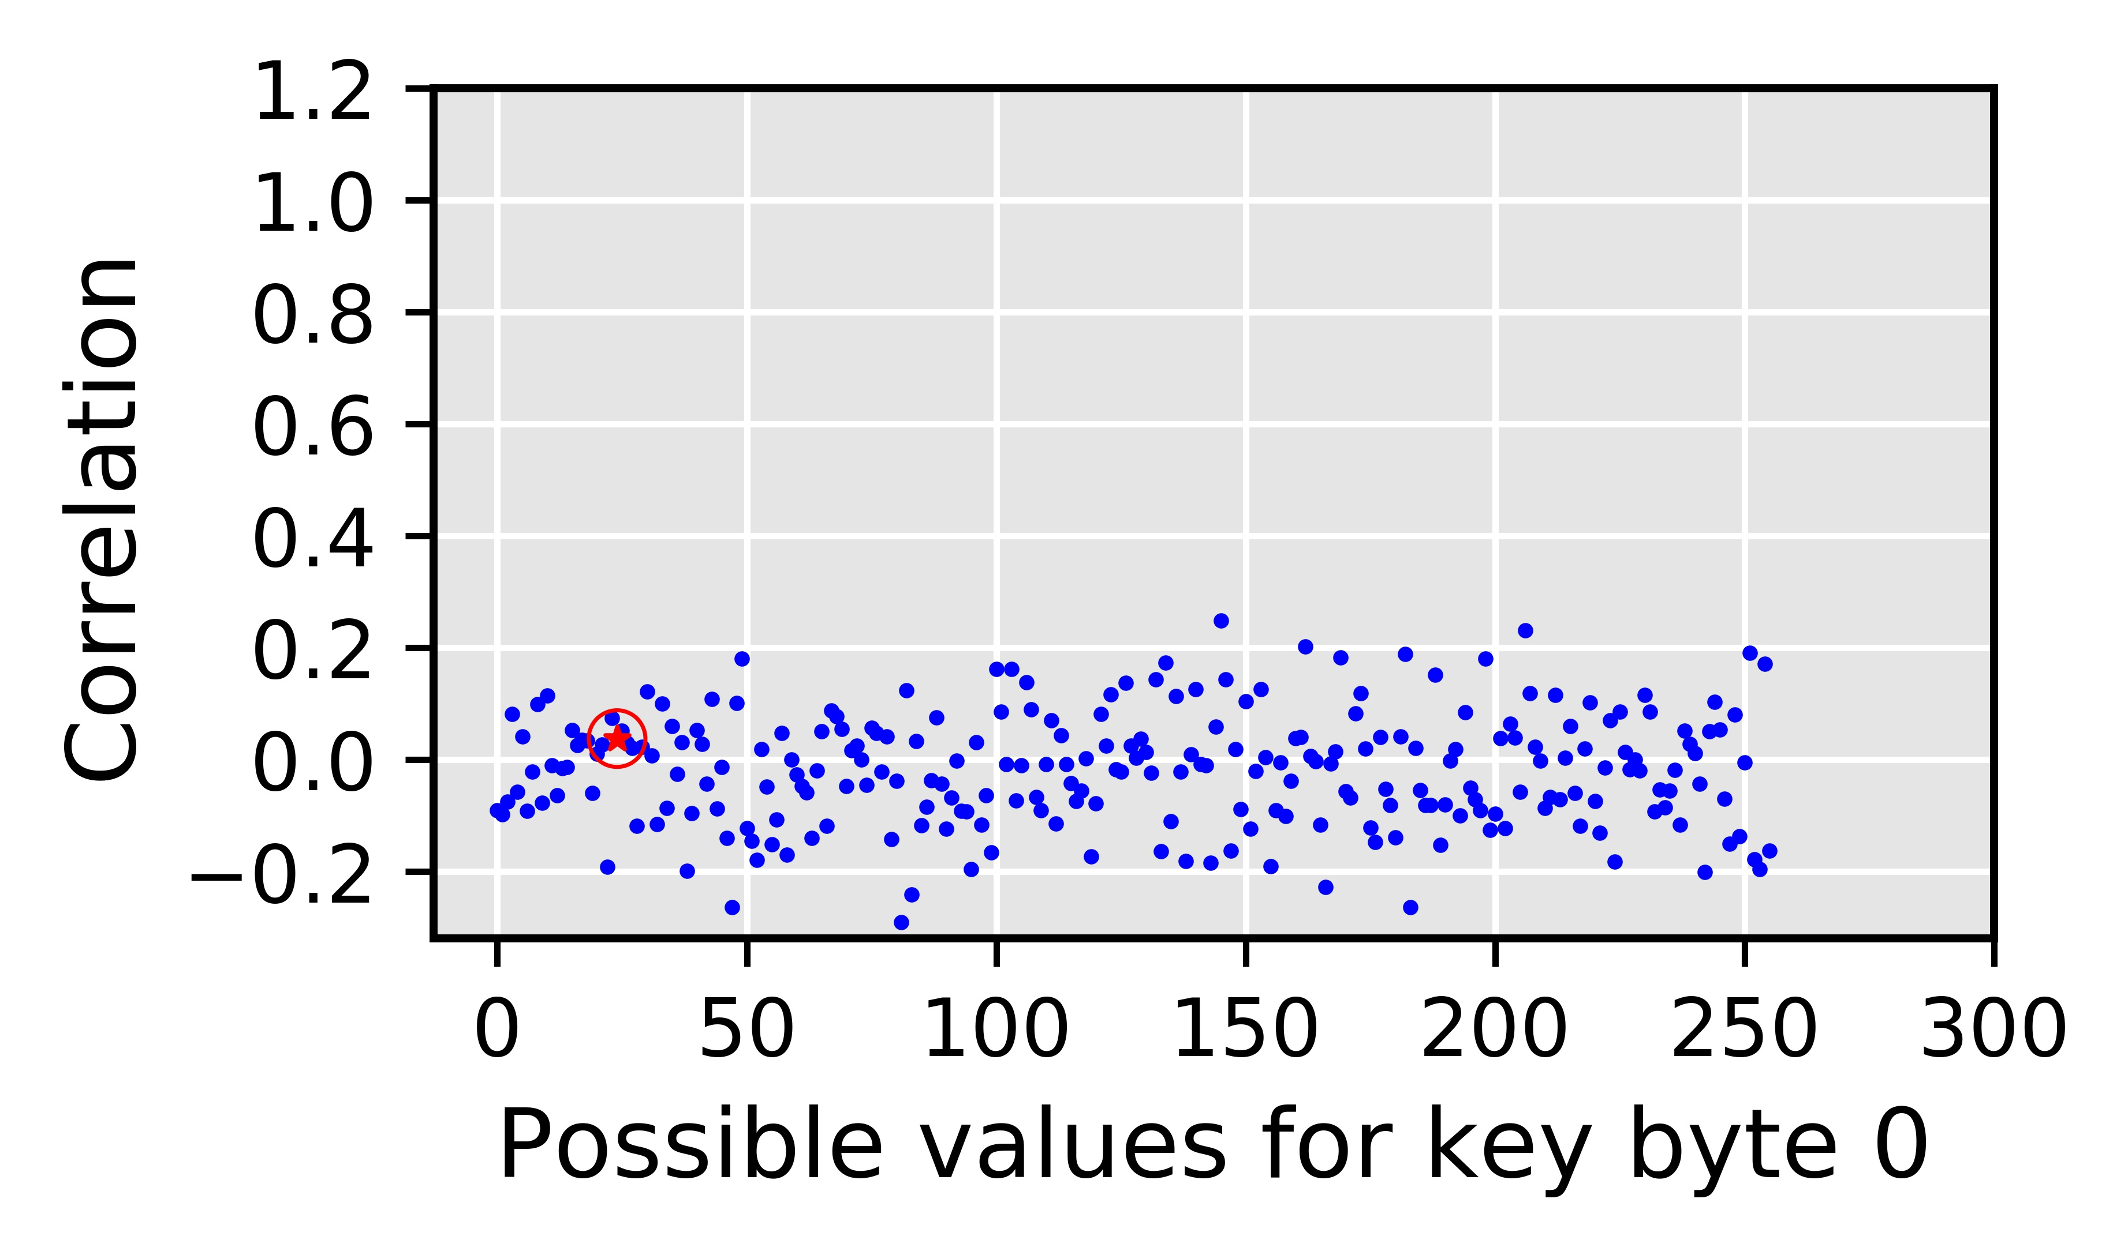
Naïve Solution
Targets the deterministic nature of the coalescing mechanism
  Fixed number of subwarps
  Fixed sizes of subwarp
  Deterministic mapping of the thread elements to subwarps
Targets the deterministic nature of the coalescing mechanism
  Fixed number of subwarps
  Fixed sizes of subwarp
  Deterministic mapping of the thread elements to subwarps
Disable coalescing altogether?
  Correlation drops to ~0
  Correct key byte is indistinguishable
Up to 178% performance degradation
  Degradation increases with plaintext size
RCoal to mitigate the correlation timing
attacks
Correct guess
RCoal to mitigate the correlation timing
attacks
Naïve solution is Good for Security, Bad for Performance
Offers no tradeoff

Slide 33
Naïve Solution
Disable coalescing altogether?
  Correlation drops to ~0
  Correct key byte is indistinguishable
Up to 178% performance degradation
  Degradation increases with plaintext size
Correct guess
Naïve solution is Good for Security, Bad for Performance
Offers no tradeoff

Slide 34
Learnings from Baseline Attack and Naïve Solution
Baseline attack leverages the deterministic nature of the coalescing mechanism
  Fixed number of subwarps
  Fixed sizes of subwarp
  Deterministic mapping of the thread elements to subwarps

Slide 35
Outline
Introduction
Background
RCoal Security Schemes
  Naïve Solution
  Fixed Sized Subwarp (FSS)
  Random Sized Subwarp (RSS)
  Random Threaded Subwarp (RTS)
Evaluation
Conclusion
targets weakness # 1: fixed number of subwarps

Slide 36
RCoal: Fixed Sized Subwarp (FSS)
DEFAULT: number of subwarps = 1
FSS: number of subwarps = 2
sid = 0
sid = 0
sid = 0
sid = 0
sid = 0
sid = 0
sid = 1
sid = 1
tid = 0
tid = 1
tid = 2
tid = 3
tid = 0
tid = 1
tid = 2
tid = 3
0x00
0x04
0x07
0x09
0x00
0x04
0x07
0x09
Coalescing Unit
Coalescing Unit
0x00
0x01
0x02
0x03
0x00
0x01
0x02
0x03
0x04
0x05
0x06
0x07
0x04
0x05
0x06
0x07
0x04
0x05
0x06
0x07
0x08
0x09
0x0A
0x0B
0x08
0x09
0x0A
0x0B
Notes:
Fixed Size Subwarp eliminates the fixed number of subwarps based determinism.

Slide 37
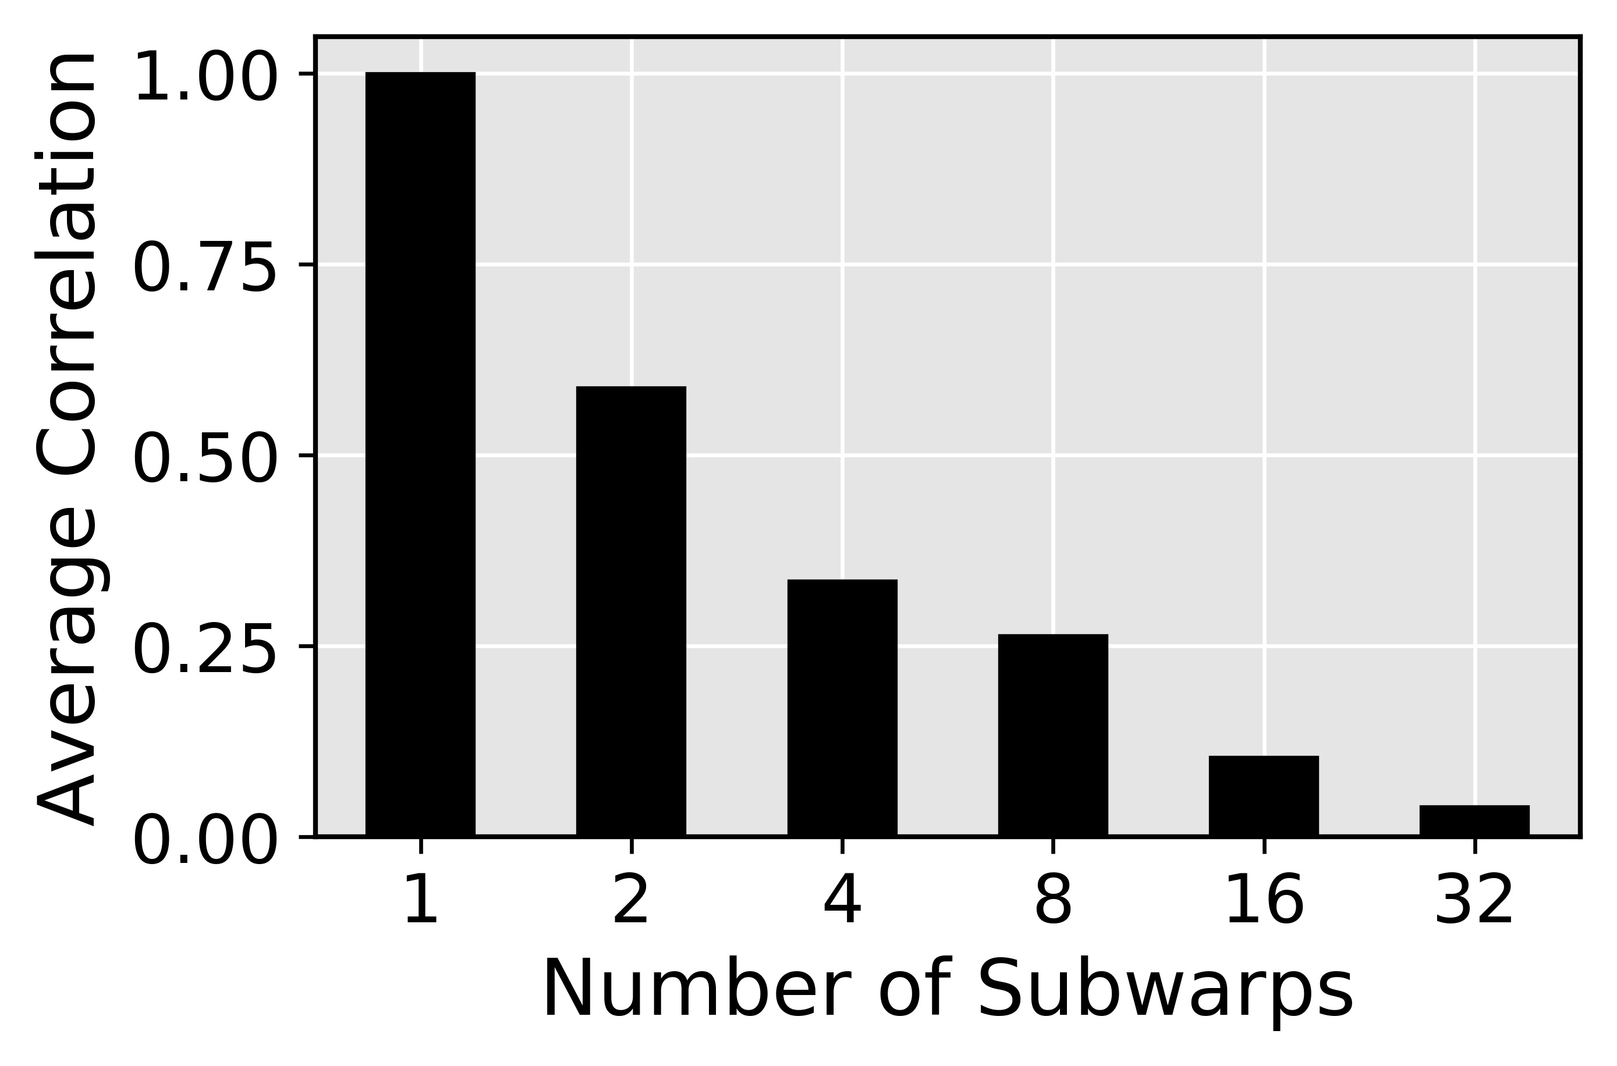
FSS Security against Baseline Attack
Correlation between the number of coalesced accesses and the execution time drops
Correct key byte is harder to find
Improved security

Slide 38
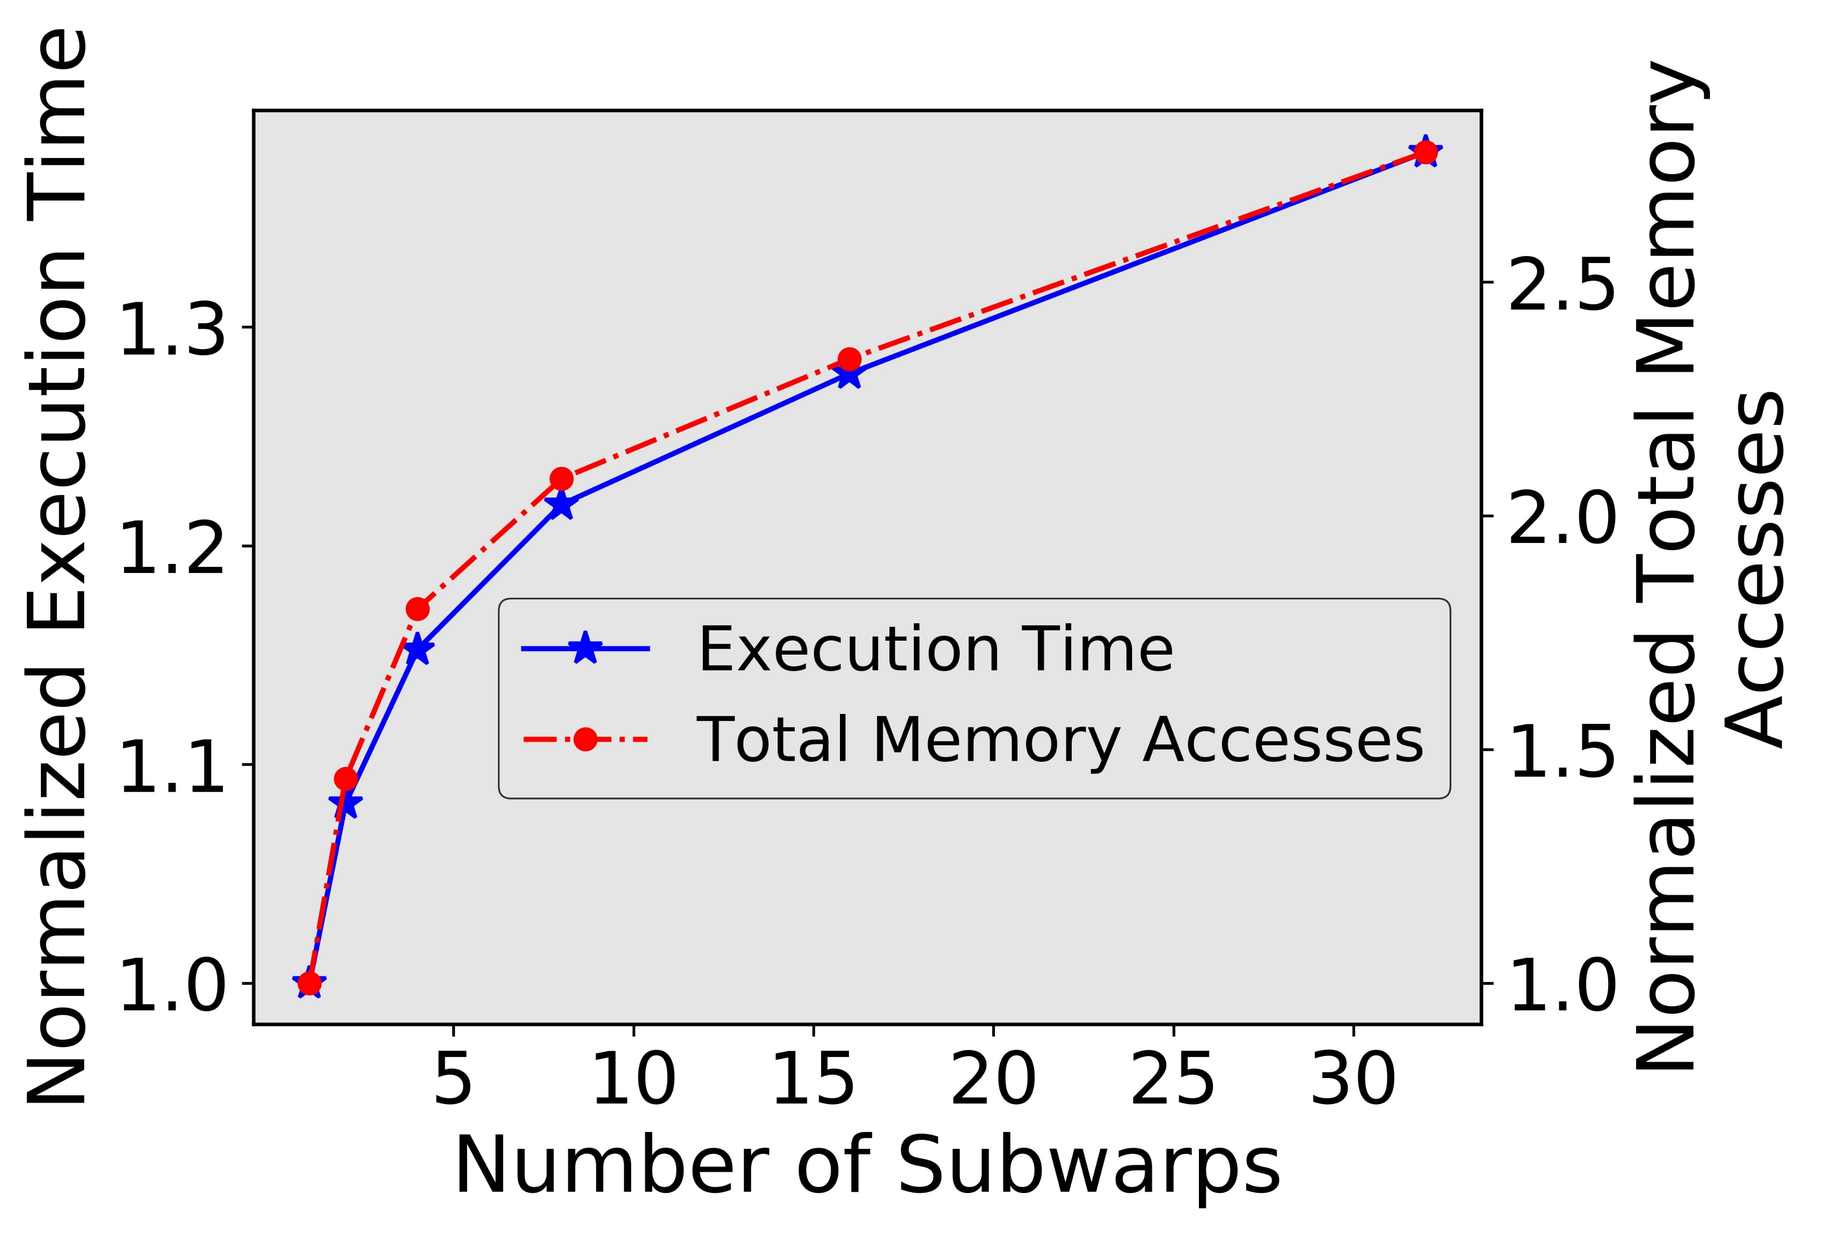
FSS Performance
Memory accesses increase with number of subwarps
Execution time increases with number of subwarps
Performance degrades as number of subwarp increase
Can attacker still recover the AES key?
Notes:
Better transition going into FSS attack

Slide 39

FSS against FSS attack
Attacker can figure out the number of subwarps
Notes:
Why FSS attack?

Slide 40
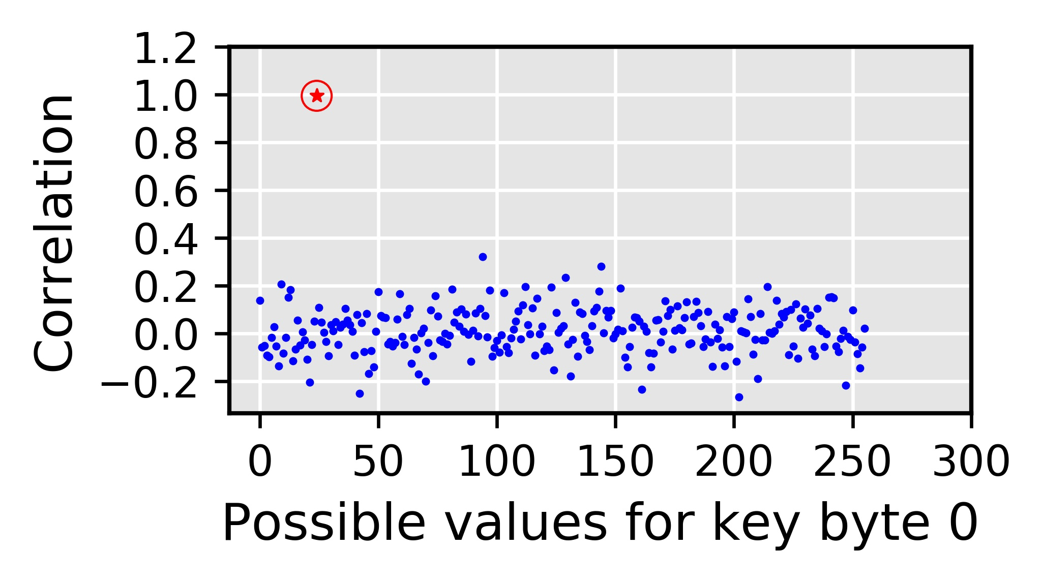
FSS against FSS attack
Attacker can figure out the number of subwarps
Attacker can calculate per subwarp accesses
Correct guess

Slide 41
FSS against FSS attack
Targets the deterministic nature of the coalescing mechanism
  Fixed number of subwarps
  Fixed sizes of subwarp
  Deterministic mapping of the thread elements to subwarps
Attack possible when the attacker can figure out number of subwarps!
  Coalescing still deterministic
RCoal to mitigate the correlation timing
attacks

Slide 42
Outline
Introduction
Background
RCoal Security Schemes
  Naïve Solution
  Fixed Sized Subwarp (FSS)
  Random Sized Subwarp (RSS)
  Random Threaded Subwarp (RTS)
Evaluation
Conclusion
targets weakness # 2: fixed size of a subwarp

Slide 43
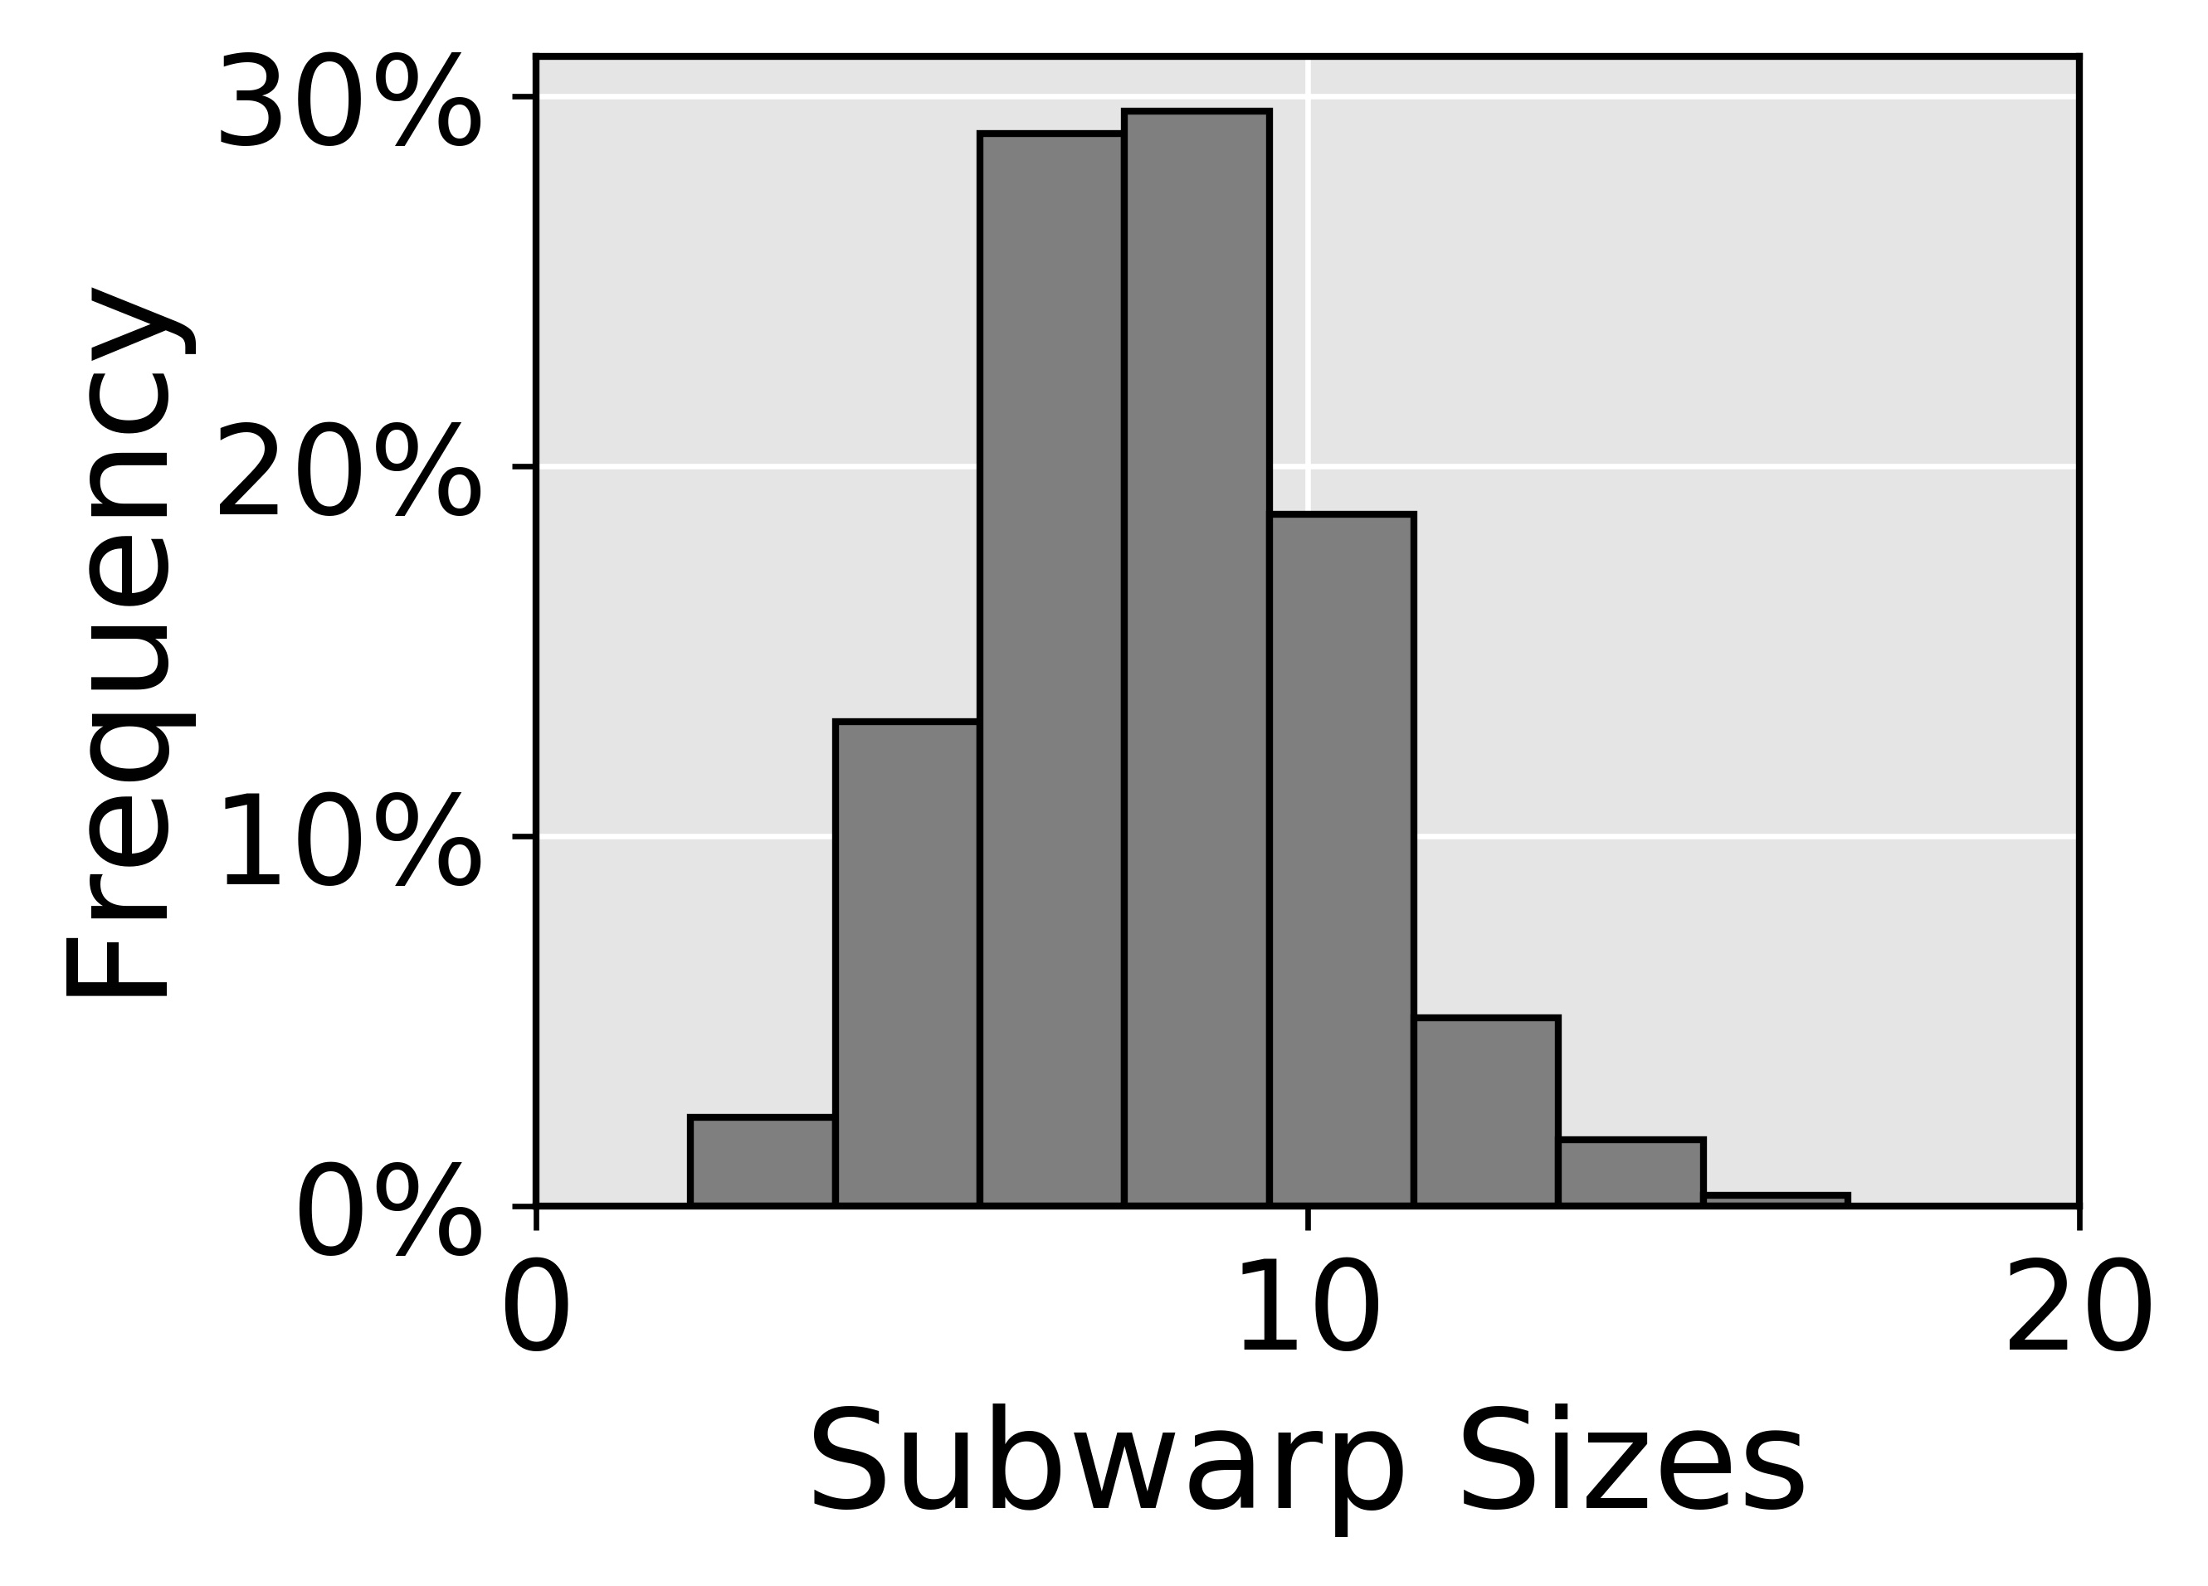
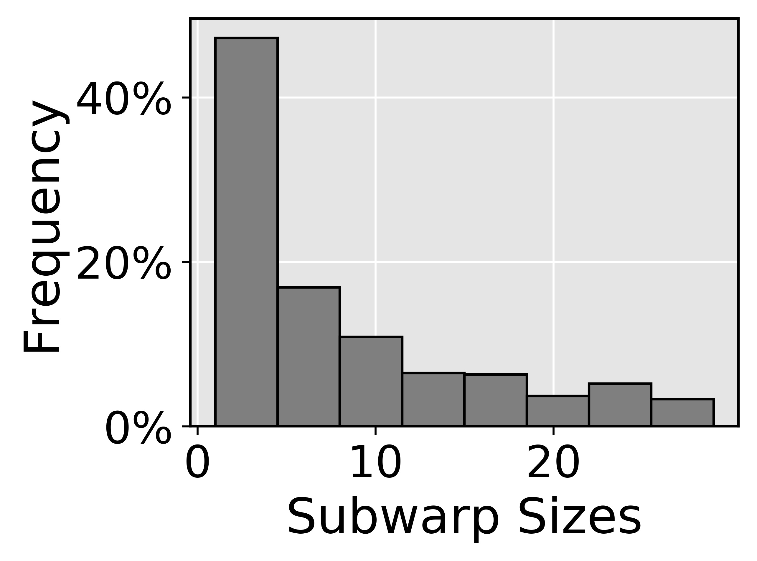
RCoal: Random Sized Subwarp (RSS)
Targets the deterministic nature of the coalescing mechanism
  Fixed number of subwarps
  Fixed sizes of subwarp
  Deterministic mapping of the thread elements to subwarps
We select RSS with Skewed Distribution
Size distribution
RCoal to mitigate the correlation timing
attacks
RCoal to mitigate the correlation timing
attacks
✗
✓
Normal Distribution
Skewed Distribution
Mean of the distribution is same as FSS
Security and performance similar to FSS
Mean of the distribution is different than FSS
Large subwarp offers better coalescing
Improved security compared to FSS
Improved performance compared to FSS

Slide 44
Outline
Introduction
Background
RCoal Security Schemes
  Naïve Solution
  Fixed Sized Subwarp (FSS)
  Random Sized Subwarp (RSS)
  Random Threaded Subwarp (RTS)
Evaluation
Conclusion
targets weakness # 3: deterministic mapping
of thread elements to subwarps

Slide 45
Random-Threaded Subwarp (RTS)
FSS: number of subwarps = 2
FSS+RTS: number of subwarps = 2
sid = 0
sid = 0
sid = 1
sid = 1
sid = 0
sid = 1
sid = 0
sid = 1
tid = 0
tid = 1
tid = 2
tid = 3
tid = 0
tid = 1
tid = 2
tid = 3
0x00
0x01
0x06
0x07
0x00
0x01
0x06
0x07
Coalescing Unit
Coalescing Unit
0x00
0x01
0x02
0x03
0x00
0x01
0x02
0x03
0x00
0x01
0x02
0x03
0x04
0x05
0x06
0x07
0x04
0x05
0x06
0x07
0x04
0x05
0x06
0x07

Slide 46
RCoal: Random-Threaded Subwarp (RTS)
FSS: number of subwarps = 2
FSS+RTS: number of subwarps = 2
tid = 0
tid = 1
tid = 2
tid = 3
tid = 0
tid = 1
tid = 2
tid = 3
0x00
0x01
0x06
0x07
0x00
0x01
0x06
0x07
sid = 0
sid = 0
sid = 1
sid = 1
sid = 0
sid = 0
sid = 1
sid = 1
Coalescing Unit
Coalescing Unit
0x00
0x01
0x02
0x03
0x00
0x01
0x02
0x03
0x00
0x01
0x02
0x03
0x04
0x05
0x06
0x07
0x04
0x05
0x06
0x07
0x04
0x05
0x06
0x07

Slide 47
RCoal: Random-Threaded Subwarp (RTS)
RSS: number of subwarps = 2
RSS+RTS: number of subwarps = 2
sid = 0
sid = 1
sid = 1
sid = 1
sid = 1
sid = 1
sid = 0
sid = 1
tid = 0
tid = 1
tid = 2
tid = 3
tid = 0
tid = 1
tid = 2
tid = 3
0x00
0x01
0x06
0x08
0x00
0x01
0x06
0x08
Coalescing Unit
Coalescing Unit
0x00
0x01
0x02
0x03
0x00
0x01
0x02
0x03
0x00
0x01
0x02
0x03
0x04
0x05
0x06
0x07
0x04
0x05
0x06
0x07
0x08
0x09
0x0A
0x0B
0x08
0x09
0x0A
0x0B

Slide 48
Outline
Introduction
Background
RCoal Security Schemes
Evaluation
Conclusion

Slide 49
Set-up
AES-128
Plaintext with 32 lines
GPGPUSIM
  15 SMs, 32 threads/warp, one subwarp per coalescing unit (base case)
  GDDR5 Memory with 6 MCs, 16 DRAM-banks, 4 bank-groups/MC
Enhanced Attack Algorithms
  Corresponding Attacks

Slide 50
RCoal Security Enhancement
Except FSS, all defense mechanisms show improvement in the security
RSS based mechanisms generally offer better security
Theoretically 24x to 961x improvement (detailed analysis in paper)
No coalescing,
No correlation

Slide 51
RCoal Performance
Performance suffers as number of subwarp increase
RSS offers better performance as compared to FSS
RTS does not affect the performance

Slide 52
Trade-off between Security and Performance

Slide 53
Security
(Lower the better)
RCoal_Score
Execution Time
(Lower the better)
Notes:
Mention Rcoal in a BOX

Slide 54
Conclusions
We proposed RCoal, a set of three novel defense mechanisms
  To mitigate the correlation timing attacks
  Randomizes the memory access coalescing
  Scales with the plaintext size (analysis in paper)
RCoal offers a trade-off between security and performance
RCoal improves security by 24- to 961- times at a modest performance loss of 5 to 28%.
Notes:
Try to reduce background and introduce rcoal_score

Slide 55
RCoal: Mitigating GPU Timing Attack via Subwarp-based Randomized Coalescing Techniques
Gurunath Kadam (College of William and Mary)
Danfeng Zhang (Penn State University)
Adwait Jog (College of William and Mary)
Thank you!
Questions?
We acknowledge the support of the National Science Foundation (NSF) grants (#1657336 and #1717532).

Slide 56
Backup Slides

Slide 57
Implementation
TID | SUB_ID | Request Size | Base Address | Offset Address
tid | sid | Entry
tid | sid | Entry
tid | sid | Entry
Bits needed
  # of threads * # warp scheduler * range
  = 32 * 2 * 5 = 320 bits
Global Memory
Memory Access Coalescing
.
.
.
.
.
.
.
.
.
Pending Request Table
.
.
.
Memory Requests from
Threads
Coalescing Unit

Slide 58
RCoal Scaling
Plaintext with 1024 lines
  32 warps
Security

Slide 59
RCoal Scaling
Plaintext with 1024 lines
  32 warps
Performance

Slide 60
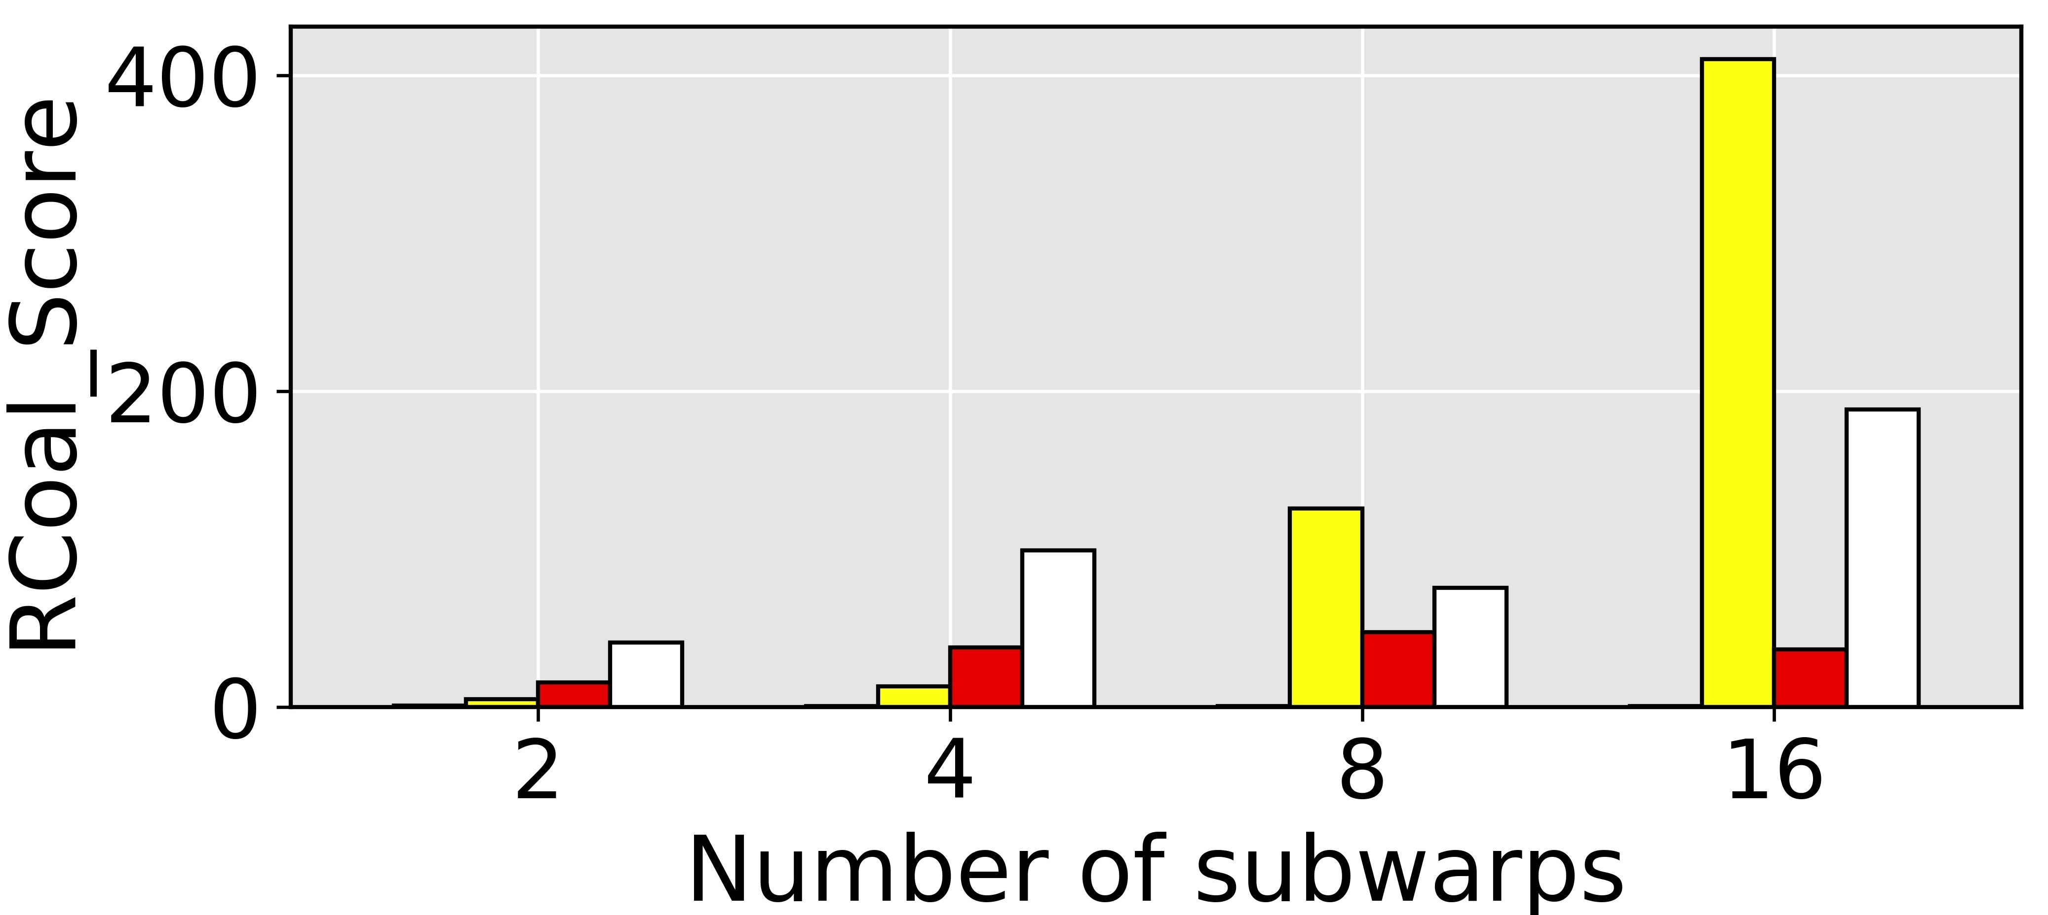
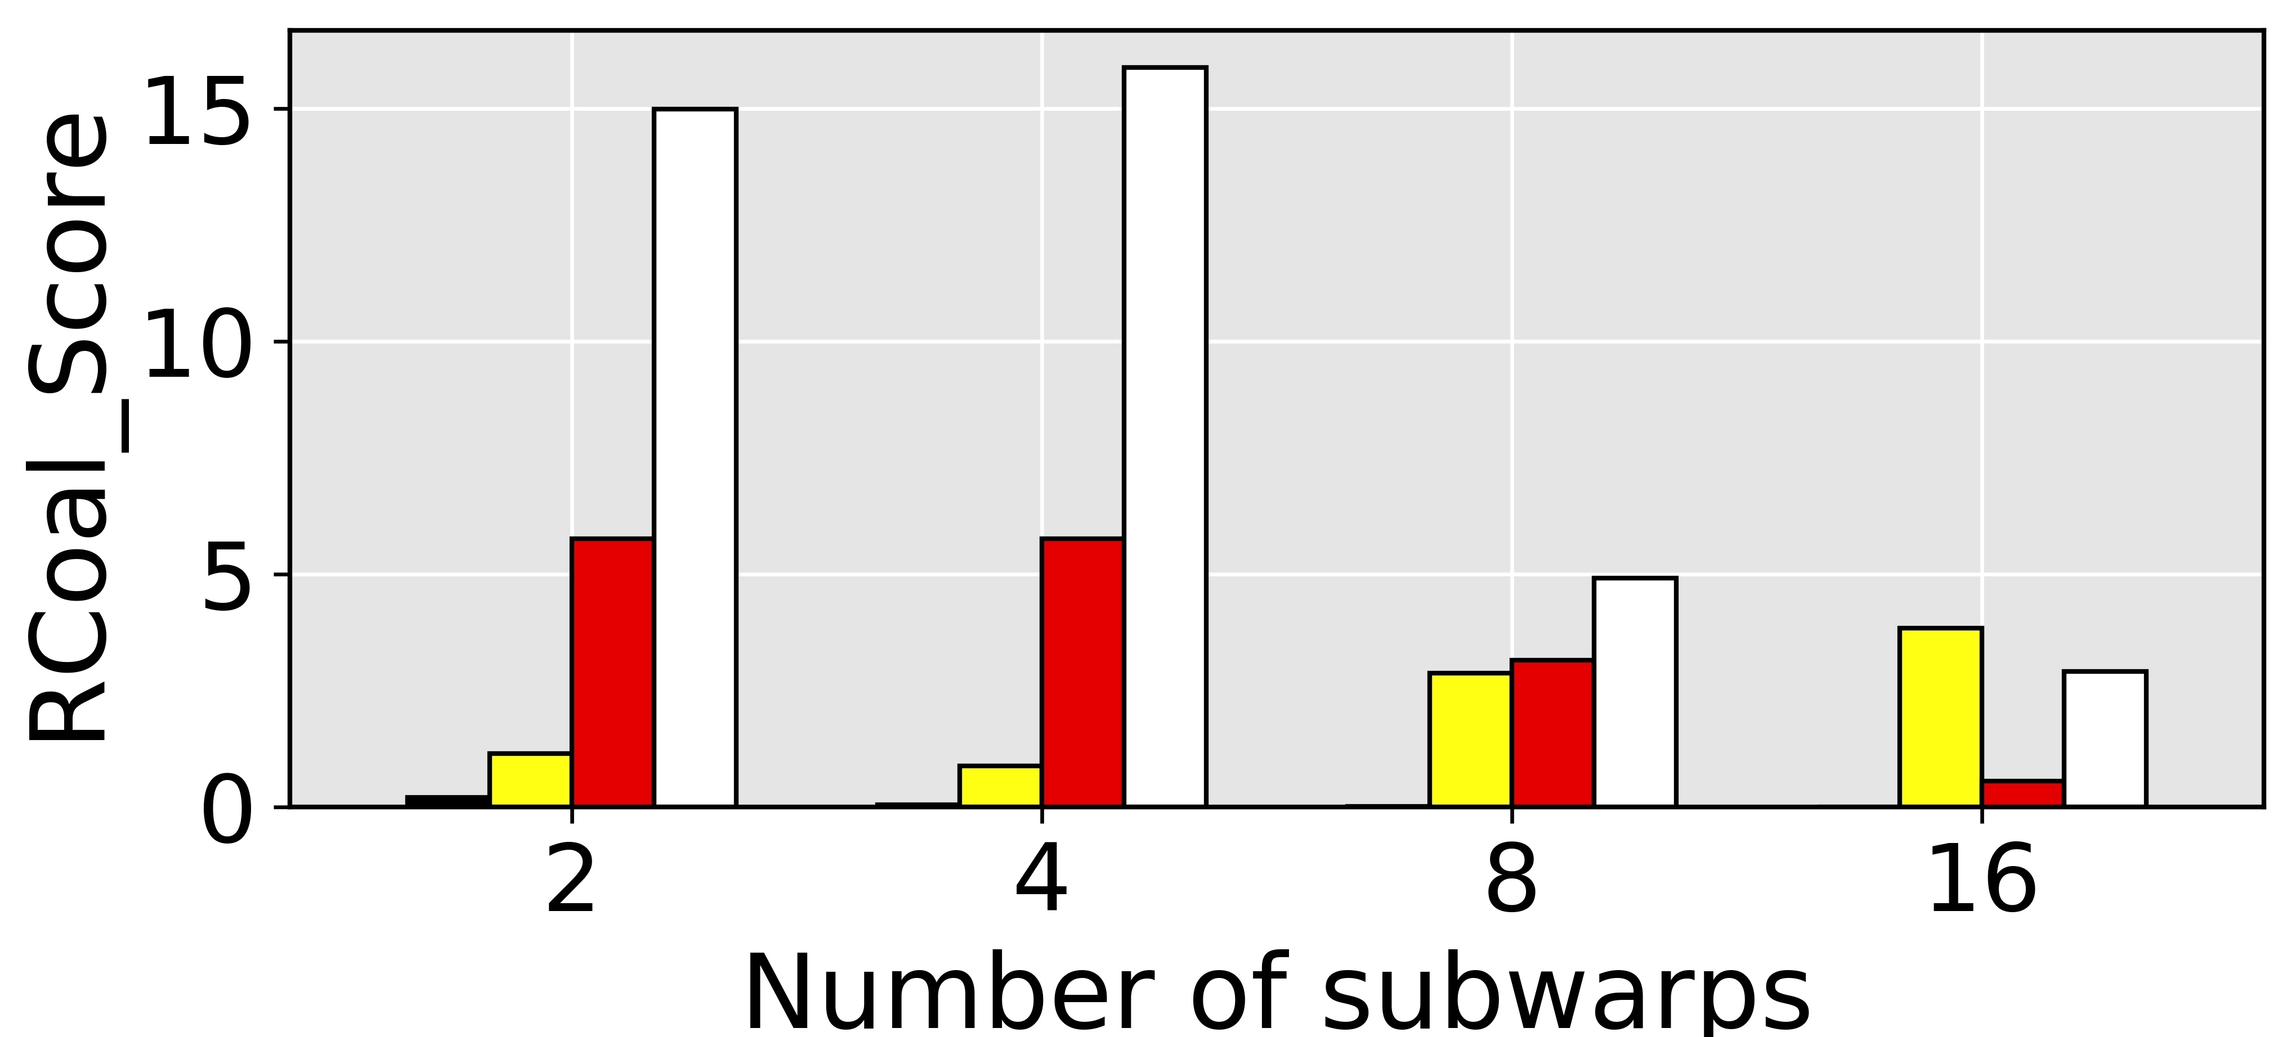
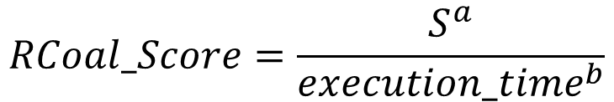
RCoal_Score
$$RCoal_Score=\frac{S^{a}}{{execution_time}^{b}}$$
Security Oriented (a=1, b=1)
Performance Oriented (a=1, b=20)

