Slide 1
Characterization of Quantum Workloads on SIMD Architectures
Rob Risque, Adwait Jog
The College of William & Mary, Williamsburg Virginia

Slide 2
Introduction
Big potential in the near future
Quantum algorithms exist, but hardware is not up to speed yet
  Google simulates hydrogen atom with 9 qubits (2016)
  Some benchmarks require hundreds of qubits
Notes:
Everyone has heard of quantum computing
Can solve complex problems better than traditional computers
What is the current progress of research?

Slide 3
Executive Summary
Research gap between quantum hardware and quantum software
We characterize various quantum workloads on different evaluation metrics to help better design quantum hardware.
We show that different quantum workloads have varied inter- and intra-SIMD region parallelism requirements.
  A multi-SIMD quantum architecture can either provide inferior performance or be severely underutilized
  Significant variation in parallelism within a single quantum application exists at different instances of its execution.
We show that data movement in SIMD quantum architectures can actually be reduced by increasing the number of SIMD regions.
Finally, we leveraged a quantum SIMD simulation framework (ScaffCC) to analyze different evaluation metrics and perform characterization studies.

Slide 4
Overview
Introduction
Background
Evaluation Metrics
Evaluation Methodology
Experimental Results
Conclusion

Slide 5
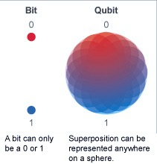
Background: Quantum computing
From bits to qubits (quantum-bits)
  Superposition
  Decoherence
Quantum logic gates
  One-qubit or two-qubit input gates
  Gate examples:
    H, CNOT, T, S, etc…..
Notes:
The main difference between traditional and quantum computing is the medium in which data is stored.
N qubits can represent 2^N binary strings simultaneously

Slide 6
Background: Quantum Data Movement
No-cloning theorem
  Cannot directly copy qubit state
Quantum teleportation
  Moves qubit state between two regions
  Requires EPR pairs
  Constant latency
Notes:
Within a quantum computer, we must move quantum data within the architecture.

Slide 7
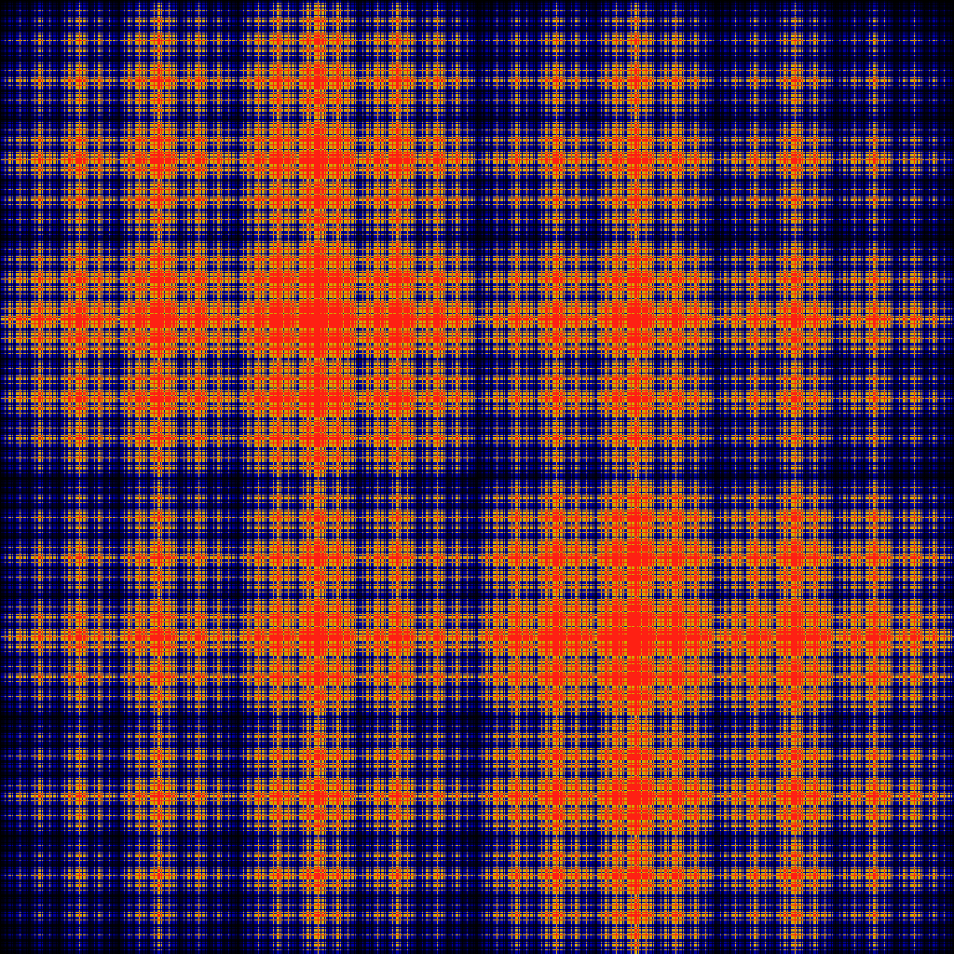
Quantum Algorithms
Ising model
  Discrete variable representation of magnetic dipole moments of atomic spin
  Statistical mechanics
Shor’s algorithm
  Integer factoring algorithm
  Cryptography
Grover’s search algorithm
  Database search algorithm
  Big data
Notes:
These are some popular quantum algorithms that leverage these quantum phenomenon in order to traverse solution spaces to these problems much faster than tradition computing algorithms.

Slide 8
Quantum SIMD Architecture
Evaluate quantum algorithms on Multi-SIMD architecture proposed by Heckey et al. [ASPLOS 2015]
This architecture has multiple SIMD operating regions to support instruction-level parallelism
Each SIMD region can operate on multiple qubits exhibiting data-level parallelism
Notes:
These quantum algorithms are mapped to quantum multi Simd architectures

Slide 9
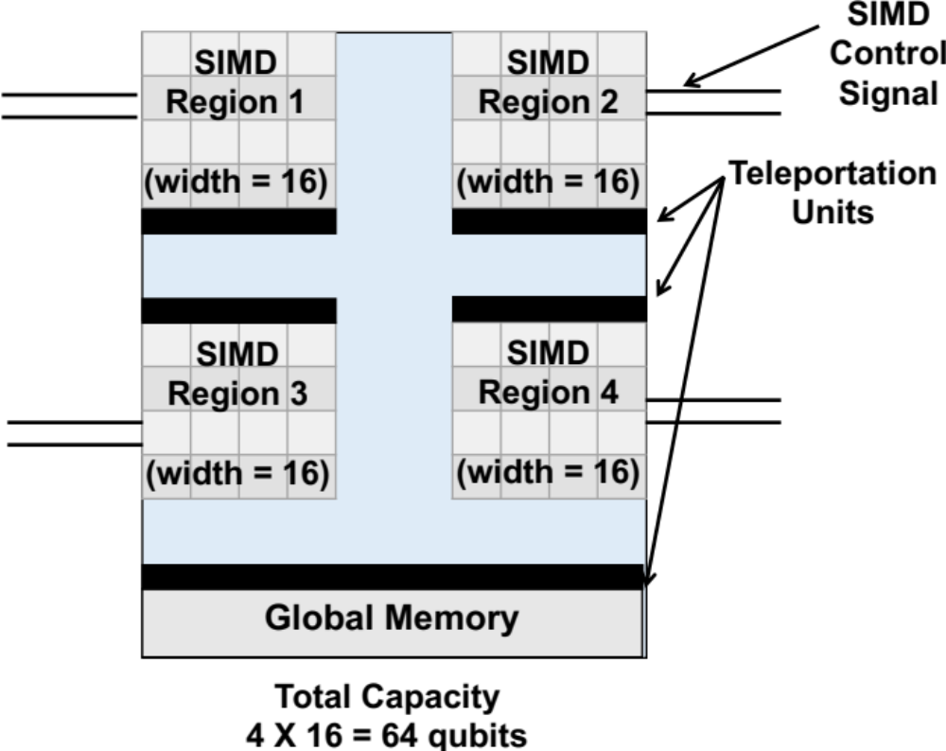
Quantum SIMD Architecture
Architectural components
  Global Memory (infinite capacity)
  K SIMD operating regions
    With qubit capacity D
  Total Capacity = K*D
  SIMD control signal
  Teleportation units

Slide 10
Sources of Inefficiencies
Microwave pulse (control signal) affects all qubits in a specified SIMD region
Global memory shields qubits from control signals
  Loss of utilization (main focus of this work)
  Moving of qubits to global memory incurs overhead
SIMD 1
q₀
q₁
H
T
CNOT
T†
CNOT
CNOT
T†
Microwave control signal
S
Notes:
Within a quantum SIMD architecture, we have identified the following inefficiencies we feel should be addresssed.

Slide 11
Overview
Introduction
Background
Evaluation Metrics
Evaluation Methodology
Experimental Results
Conclusion

Slide 12
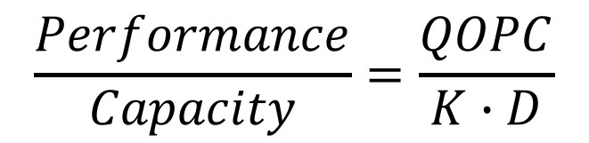
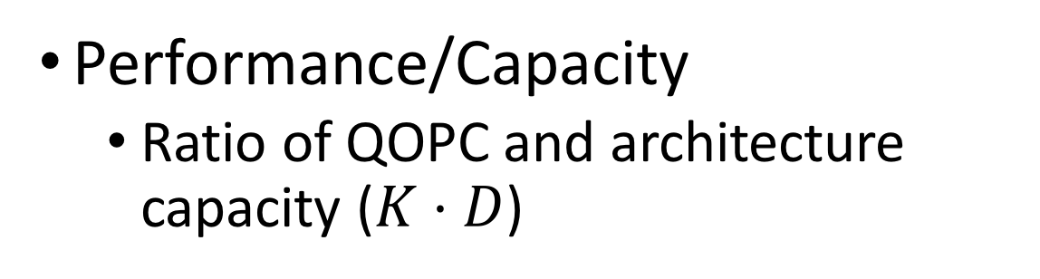
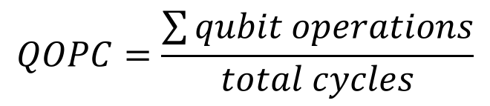
Evaluation Metrics
QOPC (quantum operations per cycle)
  Average qubit operation frequency
$$QOPC=\frac{\sum{qubit operations}}{total cycles}$$
Performance/Capacity
  Ratio of QOPC and architecture capacity ($K⋅D$)
$$\frac{Performance}{Capacity}=\frac{QOPC}{K∙D}$$
Data Movement
  Number of qubit moves

Slide 13
Evaluation Metrics
Performance (QOPC)
  Maximize QOPC to decrease benchmark runtime (decoherence)
Performance/Capacity
  Maximize P/C to maximize system utilization
Qubit (data) movement
  Minimize data movement (decoherence)

Slide 14
Timestep (cycle) | Global Memory | SIMD 1 | SIMD 2
0 | q₀, q₁, q₂
1 | q₂ | H(q₀) | T†(q₁)
2 |  | T(q₀), T(q₂) | q₁
3 | q₀ | CNOT(q_{2,} q₁)
4 | q₂ | CNOT(q_{1,} q₀)
5 |  | T†(q₁) | CNOT(q_{0,} q₂)
6 |  | CNOT(q_{1,} q₂) | T(q₀)
7 |  | T†(q₁), T†(q₂) | q₀
8 | q₂ | CNOT(q_{1,} q₀)
9 |  | S(q₁) | CNOT(q_{0,} q₂)
10 |  | H(q₀) | CNOT(q_{2,} q₁)
Global Memory
q₀
q₁
q₂
SIMD 1
SIMD 2
H
CNOT
T
CNOT
T†
CNOT
CNOT
T†
H
T†
S
T
CNOT

Slide 15
Timestep (cycle) | Global Memory | SIMD 1 | SIMD 2 |  | QOPC | Performance per Capacity | Moves
0 | q₀, q₁, q₂
1 | q₂ | H(q₀) | T†(q₁) |  | 2 | 0.5 | 2
2 |  | T(q₀), T(q₂) | q₁ |  | 2 | 0.5 | 1
3 | q₀ | CNOT(q_{2,} q₁) |  |  | 2 | 0.5 | 2
4 | q₂ | CNOT(q_{1,} q₀) |  |  | 2 | 0.5 | 2
5 |  | T†(q₁) | CNOT(q_{0,} q₂) |  | 3 | 0.75 | 2
6 |  | CNOT(q_{1,} q₂) | T(q₀) |  | 3 | 0.75 | 1
7 |  | T†(q₁), T†(q₂) | q₀ |  | 3 | 0.75 | 0
8 | q₂ | CNOT(q_{1,} q₀) |  |  | 2 | 0.5 | 2
9 |  | S(q₁) | CNOT(q_{0,} q₂) |  | 3 | 0.75 | 2
10 |  | H(q₀) | CNOT(q_{2,} q₁) |  | 3 | 0.75 | 2
Average |  |  |  |  | 2.5 | 0.625 | 1.6

Slide 16
Overview
Introduction
Background
Evaluation Metrics
Evaluation Methodology
Experimental Results
Conclusion

Slide 17
Evaluation Methodology
ScaffCC
  Quantum code compiler
  Benchmarks written in Scaffold (similar to C)
  Resource estimation
  Coarse-grained and fine-grained schedules
Evaluate each benchmark
  For different K, D combinations
Benchmarks
  Binary Welded Tree, Class Number, Ground State Estimation, Ising Model, Quantum Fourier Transform, Square Root, Toffoli, Triangle Finding Problem

Slide 18
Overview
Introduction
Background
Evaluation Metrics
Evaluation Methodology
Experimental Results
Conclusion

Slide 19
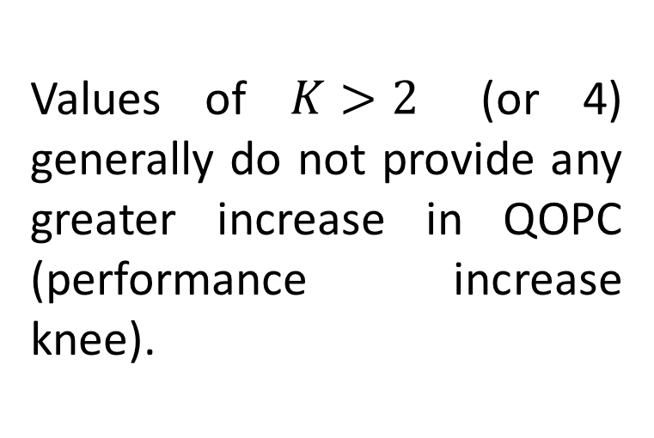
Performance (QOPC) analysis
Best parameters:
K≤4
Conclusions:
The number of SIMD regions K has a much greater positive impact on QOPC than the capacity of a region (D).
Values of $K>2$ (or 4) generally do not provide any greater increase in QOPC (performance increase knee).
Notes:
Therefore, it is important to leverage quantum logic gate (instruction)-level or inter-region parallelism in quantum applications for better performance.

Slide 20
Performance (QOPC) analysis, ISO-capacity
Conclusion:
For ISO-capacity, higher K and lower D results in best QOPC values for all benchmarks.
Best parameters:
8x4

Slide 21
QOPC over time
QOPC varies over time depending on both K and D
Time
Time

Slide 22
Performance/Capacity
Best parameters:
K=2,4
D=2
Conclusion:
Both K and D have significant effects on Performance/Capacity.

Slide 23
Qubit Movement
Conclusions:
At low K values, D is negatively correlated with qubit moves.
At high K values, D is positively correlated with qubit moves.
Increasing K will always reduce data movement

Slide 24
Qubit Movement, ISO-capacity
Conclusion:
For ISO-capacity, higher K and lower D results in minimal data movement.
Best parameters:
8x4

Slide 25
Qubit Movement over time
Qubit movement varies over time depending on both K and D
Time
Time

Slide 26
Conclusions
We analyzed different evaluation metrics to measure the efficiency of Quantum Multi-SIMD architectures
Our results show that different benchmarks have different intra- and inter- region parallelism characteristics
We observe that
  QOPC is mostly affected by the number of SIMD regions
  Performance/Capacity is affected by both the number and capacity of regions
  Data movement can be reduced by increasing the number of SIMD regions
We hope that the observed insights can be useful in designing new scheduling algorithms that consider:
    System utilization, Communication latency, and other Hardware organizations

Slide 27
Thank You
Questions?

