Slide 1
Design and Analysis of Soft-Error Resilience Mechanisms for GPU Register File
Sparsh Mittal¹, Haonan Wang², Adwait Jog², Jeffrey S. Vetter³
¹IIT Hyderabad, India
²College of William and Mary, USA
³Oak Ridge National Lab, USA
VLSID 2017
Support provided by USA Dept. of Energy, Office of Science, Advanced Scientific Computing Research, IITH and College of William and Mary

Slide 2
Presentation Plan
Need of improving SE resilience
RF size trends and background
Compression techniques: WarpC and ThreadC
Selective hardening
Salient features and overhead
Experimental platform and workloads
Results and analysis
Conclusion and Future Work

Slide 3

Increasing impact of faults on modern processors
With ongoing voltage scaling, the critical charge required for flipping is decreasing.
Now, even lower-energy particles, which are more numerous, can also cause soft-errors
The financial and social impact of faults can be huge
0000
0010
Particle strike can flip a value
Reliability has now become the primary optimization
target in processor design

Slide 4
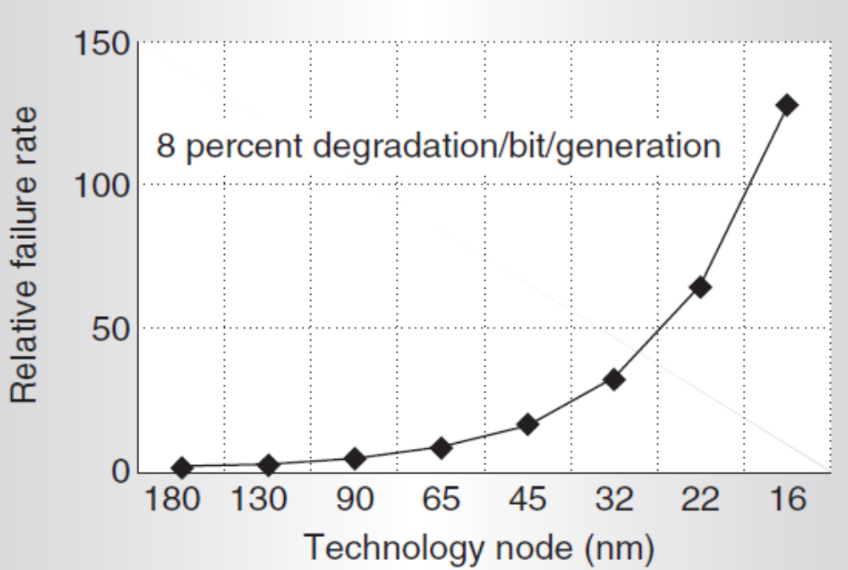
Trends: Exponentially increasing soft-error rate
Feature size scaling trends have exacerbated the occurrence and impact of faults
Soft-error failure rate at 16nm ≈ 100 times that at 180nm
Soft-error failure-in-time
of a chip [Bor05]
[Bor05] S. Borkar, "Designing reliable systems from unreliable components: the challenges of transistor variability and degradation", Micro, 2005

Slide 5
Trends: RF size on GPUs is increasing
Architectural parameters of recent NVIDIA GPUs
 | Architecture | Compute Capability | L1 size (KB) | L2 size (KB) | RF size (KB) | # of SMs | Total RF size (KB)
G80 | Tesla | 1.0 | None | None | 32 | 16 | 512
GT200 | Tesla | 1.3 | None | None | 64 | 30 | 1920
GF100 | Fermi | 2.0 | 48 | 768 | 128 | 16 | 2048
GK110 | Kepler | 3.5 | 48 | 1536 | 256 | 15 | 3840
GK210 | Kepler | 3.7 | 48 | 1536 | 512 | 15 | 7680
GM204 | Maxwell | 5.2 | 48 | 2048 | 256 | 16 | 4096
GP100 | Pascal | 6.0 | 48 | 4096 | 256 | 56 | 14336
AMD Radeon HD 7970 GPU: 16 KB L1 per computing unit, 768KB shared L2 and a total of 8.25 MB RF
Due to large size and high access frequency,
GPU RF becomes vulnerable to soft-errors

Slide 6
Error-masking due to writes
Invulnerable (i.e., not critical)
W
R
R
W
R
W
R
R = Read
W = Write
Vulnerable (i.e., critical)
Key insight: not every fault leads to final error
Register data are
  Vulnerable from write to read (called ‘critical time’)
  Not vulnerable from read to write

Slide 7
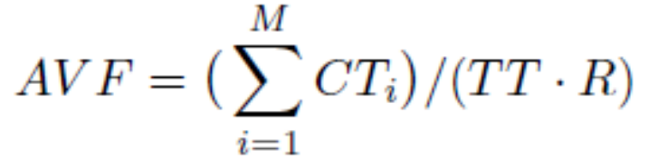
Measuring soft-error vulnerability (SEV)
We measure cache vulnerability based on architectural vulnerability factor (AVF) metric [Muk03]
AVF measures the fraction of time RF is vulnerable to soft errors, i.e., when a circuit-level soft-error gets propagated to other components
Here, TT = total execution time, CT_{i} = critical time of a critical register i, M = total critical registers, R = total registers
[Muk03] S. S. Mukherjee et al., “A systematic methodology to compute the architectural vulnerability factors for a high-performance microprocessor,” MICRO, 2003.

Slide 8
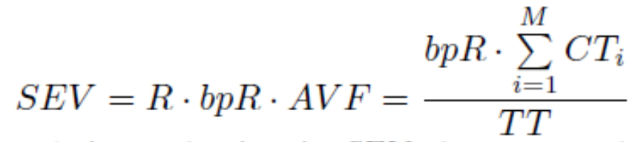
Measuring soft-error vulnerability (SEV)
Here, bpR = # bits per register
Clearly, vulnerability can be reduced by:
  1. Reducing number of bits in critical register
  2. Designing RF with radiation-hardened cells
  3. Reducing CT, e.g., by instruction rescheduling
This
paper

Slide 9
Our Contributions
We propose two techniques
Compressing the register values to reduce the number of data-storing (i.e., vulnerable) bits
  Warp-level compression (WarpC)
  Thread-level compression (ThreadC)
Selective hardening of registers
WarpC uses BDI compression algorithm
ThreadC uses narrow-value detection

Slide 10
WarpC: Key Idea
Thread registers of a warp show high value similarity due to
  Initialization by a constant
  Iteration for a fixed number of times
  Accessing data portions using thread indices
Many thread registers store zero value due to
  Nature of program inputs or initialization
  Operating on sparse matrices
WarpC exploits these to compress
warp-registers using BDI compression

Slide 11
BDI algorithm exploits low dynamic range
  Zero Values: initialization, sparse matrices, NULL pointers
0x00000000
0x00000000
0x00000000
0x00000000
…
  Repeated Values: common initial values, adjacent pixels
0x000000FF
0x000000FF
0x000000FF
0x000000FF
…
  Narrow Values: small values stored in a big data type
0x00000000
0x0000000B
0x00000003
0x00000004
…
  Other Patterns: pointers to the same memory region
0xC04039C0
0xC04039C8
0xC04039D0
0xC04039D8
…
[Pek12] G. Pekhimenko et al., “Base-delta-immediate compression: practical data compression for on-chip caches,” PACT, 2012

Slide 12
An example of SEV reduction using WarpC
BDI represents a value as Base and Deltas
4 byte
Lead to bit-flip
0x00000001
0x00000009
0x00000001
0x00000004
0x00000003
0x00000006
0x00000008
0x00000005
(a) 8 uncompressed 4B thread-registers (total 32B)
Leads to bit-flip
No effect
Base
0x00000001
0x08
0x00
0x03
0x02
0x05
0x07
0x04
Saved space
4 byte
1 byte
1 byte
21 bytes
(b) 11B storage after compression with B4D1 state
(Assuming 8 thread-registers instead of 32 for simplicity)

Slide 13
Optimizations
We use only three BDI compression states: AllZero, B4D0 and B4D1 to reduce latency
Accounting for criticality of base
  At decompression, base is added to all the values, so an error in base can propagate to other values also
  Base becomes critical!
  We store two copies of base to provide extra protection
WarpC is not performed while writing divergent warps
  They show reduced value locality

Slide 14
ThreadC: Key Idea
Compresses each thread-register individually
Requires 32 compressors => use only simple compression circuit
We use narrow-value detection, e.g., only 1B data stored in a 4B register
ThreadC determines width (K) from four values: 0B, 1B, 2B and 4B (uncompressed)
On a register read, only lower K bytes are read

Slide 15
ThreadC vs WarpC: Tradeoffs
WarpC
ThreadC
Exploits: value similarity and 0 values
Cannot benefit divergent warps
More effective for non-divergent warps
Exploits: narrow and 0 values
Can benefit divergent and non-divergent warps
Less effective for non-divergent warps
To bring their best together, we propose recording application divergence characteristic for an epoch and then choosing b/w WarpC and ThreadC

Slide 16
GPU RF architecture with our technique
Execution units
SFUs
……..
ALUs
……..
LDST
Ready
warps
Operand collectors
………….
………….
Decompressor
………….
………….
Crossbar network
REG 0
………….
………….
REG 1
Arbiter
Bank 0
……….
Bank 7
……….
Bank 15
Read
Queue
0 - 15
REG 63
1024 bits
Register file
RF bank
Compressor
Register
IDs

Slide 17
Selective Hardening
Compression is not a panacea
We need another approach to benefit all apps
We propose designing left-most H bytes (out of 128B) using hardened circuits, e.g., 10T SRAM [Jah09]. It provides 14% less SE rate than ECC-protected SRAM and 98% less SE rate than baseline 6T SRAM
Can be combined with compression
Example (total storage 128B):
  No compression, H=16B => 112B vulnerable
  B4D0 state => data in lower 4B only. If H=16B => 0B vulnerable!
[Jah09] S. Jahinuzzaman et al., “A soft error tolerant 10T SRAM bit-cell with differential read capability,” TNS, 2009.

Slide 18
Salient Features of Our Techniques
Applicable to other RF architectures also
Hardening overhead is comparable to ECC [Pal14]
Hardening avoids multi-bit faults, whereas multi-bit ECCs incur very high overheads
Designing entire RF with hardened memory incurs unacceptably high overhead
Previous SE-reduction techniques do not exploit value similarity
Can benefit whole range of GPU applications
[Pal14] Precision-Aware Soft Error Protection for GPUs, HPCA’14

Slide 19
Overhead Estimation
Latency overhead
WarpC: 2 cycle compression, 1 cycle decompression
ThreadC: 1 cycle compression, no overhead in decompression
Storage overhead:
WarpC: 2 bits/ warp, ThreadC: 2 bits/thread
Our techniques reduce data access and wire movement energy. They only involve addition, subtraction and/or bit-comparison

Slide 20
Experiments
GPGPUSim v3.2.2 simulator
GPU configuration similar to NVIDIA Fermi GTX480
SM Frequency | 700 MHz
No. of SMs | 15
RF size and banks | 128 KB, 16 banks
Maximum warps per SM | 48
Scheduling policy | GTO (greedy then oldest)
20 applications from Lonestar, ISPASS09, Rodinia, Parboil, and CUDA SDK suites
mst (MST), sp (SUP), sssp (SSP), bfs (BFS), LPS (LPS)
NN (NEN), NQU (NQU), gaussian (GSS), heartwall (HWA)
hotspot(HOS), needle(NED), particlefilter (PFL), pathfinder (PAF)
cutcp(CUT), mri-q(MRQ), tpacf(TPF), alignedtypes (ALT)
matrixmul (MML), reduction (RDC), streams (STR)

Slide 21
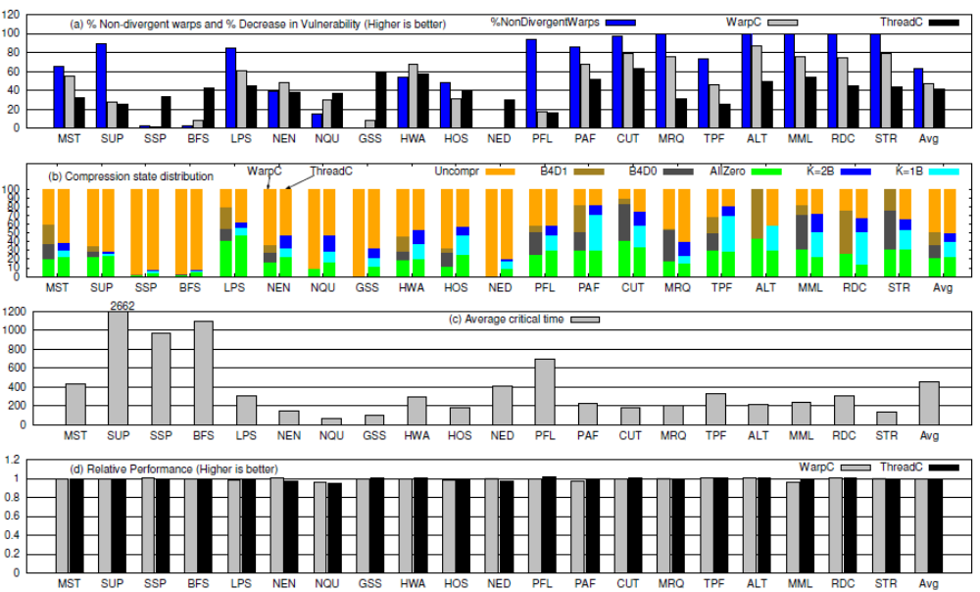
Results with compression only
% Non-divergent warps and % Decrease in Vulnerability (Higher is better)
(b) Compression state distribution

Slide 22
Result Analysis
SEV reduction depends on fraction of non-divergent warps (for WarpC) and RF value compressibility
For apps with many non-divergent warps, WarpC provides large reduction in SEV, e.g., MST, PAF, CUT, MRQ, TPF, ALT, RDC, STR, etc
For some apps, most warps are divergent, for NED (100%), GSS (99.7%), SSP (97.5%), BFS (97.1%)
WarpC doesn’t benefits these apps. For these and others (NQU, HWA),ThreadC provides higher benefit
=> One compression technique: not optimal for all apps
WarpC and ThreadC can compress 50.1% and 49.3% of writes

Slide 23
Results with compression only
(c) Average critical time
459 cycles
(d) Relative performance (higher is better)
Critical time can be as high as 2662 and 1092 cycles
Registers remain vulnerable for long periods => there is a need to reduce their SEV
Average performance loss < 1%

Slide 24
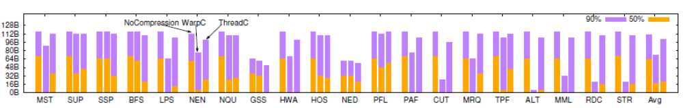
Results with compression and hardening
Hardening requirement for reducing SEV by 50% and 90%
Average results
 | 50% | 90%
No Compression | 62B | 110B
WarpC | 18B | 74B
ThreadC | 21B | 102B
Value for 90% is the height of the whole bar

Slide 25
Result Analysis
For many apps, compression alone can reduce SEV by 50% => no need of hardening
Even for reducing SEV by 90%, several benchmarks require only few hardened bytes on using compression
WarpC stores the register in left-aligned manner to preferentially use hardened memory, whereas ThreadC stores each thread-register in its own place.
=> ThreadC provides lower benefit with hardening than WarpC
See the paper for parameter sensitivity results.

Slide 26

Conclusion and Future Work
We presented compression and hardening for reducing SEV of GPU RF.
Future Work
  Improving resilience of other GPU components
  Evaluating multi-bit faults

Slide 27
References
S. Mittal et al., “A Survey of Techniques for Modeling and Improving Reliability of Computing Systems,” IEEE TPDS, 2015.
S. Mittal, “A Survey of Techniques for Architecting and Managing GPU Register File,” IEEE TPDS, 2016.
S. Lee et al., “Warped-compression: enabling power efficient GPUs through register compression,” ISCA, pp. 502–514, 2015.

