Slide 1

Address-Stride Assisted
Approximate Load Value Prediction in GPUs
Haonan Wang, Mohamed Ibrahim (College of William & Mary),
Sparsh Mittal (IIT Hyderabad),
Adwait Jog (College of William & Mary)

Slide 2
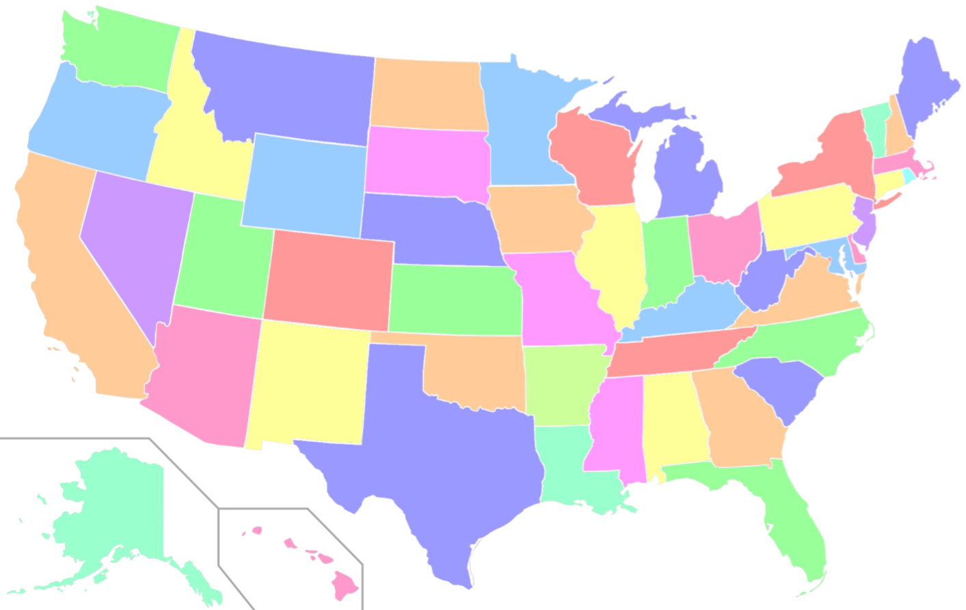




Haonan
I don’t actually need to go.
Wait.. this is exactly the case for Value Approximation. If a value is correlated with existing local values, it does not need to be fetched from the memory!
June 26, DSN
presentation
Portland, OR
(DSN)
Haonan
Adwait
I’m correlated with Haonan. I can present for him.
Consumes time/energy Also, I might be late!
Williamsburg, VA
(William & Mary)
June 27, ICS
presentation
Phoenix, AZ
(FCRC)

Slide 3
Executive Summary
Problem: Data movement across different levels of the memory hierarchy
  High energy consumption and memory bandwidth utilization
  Existing value prediction solutions are not optimal
Observation: Values can be more accurately predicted by exploiting correlation between the address stride and the value stride
  Exists in many data inputs processed by GPU applications
Solution: ASAP – a novel value approximation technique for GPUs
  Low hardware overhead
  Better prediction accuracy

Slide 4
Outline
Background & Motivation
Design of ASAP
Evaluation
Conclusion

Slide 5
GPU Architecture with a (Roll-back Free) Value Predictor
Core
If certain quality loss can be tolerated
Rollbacks are not needed
R2
R1
Core1
Core2
Core30
…
L1 Cache
Training/Update Data
Value
Predictor
(VP)
Value
L1
VP
L1
VP
L1
VP
Predicted Data
Value
Interconnect
L2
L2
…
L2
DRAM
DRAM
DRAM
Interconnect
L2 Cache
DRAM
R1
Notes:
After the prediction, if the predicted value is not the correct value, the execution of the program must be rolled back to the state before the prediction. However, if …

Slide 6
CPUs: Prior Value Prediction Works
Context based predictor:
Use context table (containing history PCs) to index into prediction table
Hash function based predictor:
Use instruction info (e.g., PCs) to index into prediction table
Not optimized for GPUs:
Use per-thread large prediction table – expensive for multi-threading
Does not directly consider the memory access order
Does not handle memory divergence
Notes:
Roll back is more expensive in GPUs.

Slide 7
GPUs: Prior Value Prediction Works
Sub-predictor 1
Sub-predictor 2
Rollback-Free Value prediction (RFVP)
Value Base0
Value Stride1
Value Base16
Value Stride2
PC
One Stride Predictor (OSP):
Training:
Stride = Difference between Values
Prediction:
Value = Base + Stride
Hash Fn
Warp ID
....
word 0-15
word 16-31
Limitations:
Does not consider memory addresses and their order
-- Limiting the predictability of values
Using per Warp and PC information
-- May require large number of entries
Two Stride Predictor (TSP):
In training, it confirms:
Current Stride = Previous Stride
Amir Yazdanbakhsh, et al. “RFVP: Rollback-Free Value Prediction with Safe-to-Approximate Loads.” TACO’2016.
Notes:
Mention TSP. – add confidence to training

Slide 8
How can we improve existing GPU value predictors?

Slide 9
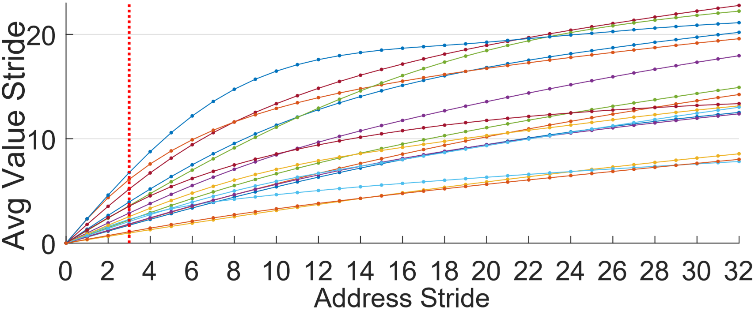
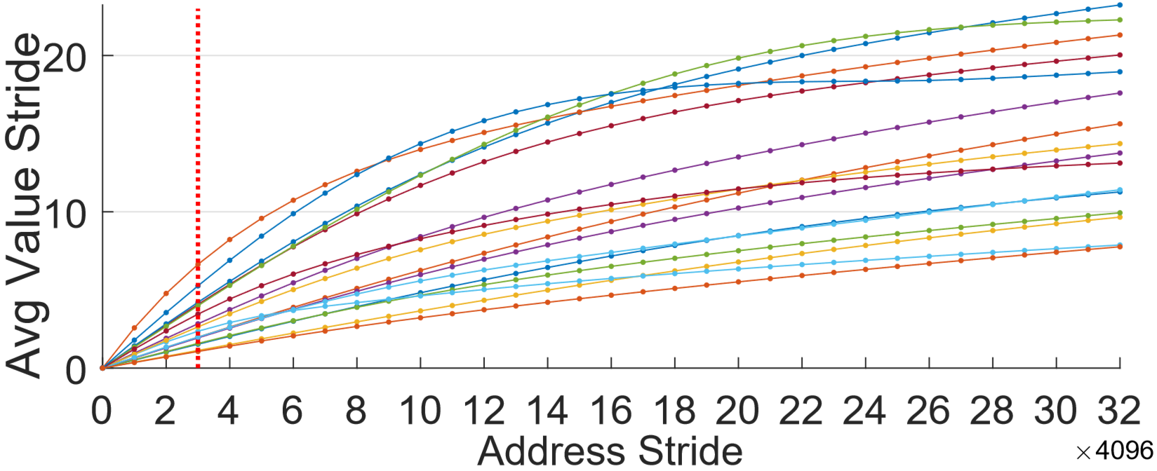
Observation: Address Stride & Value Stride Correlation
Row-major:
Column-major:
Nearby pixels are related (e.g., have linearly increasing grayscales).
row size
Tracking address strides can help in better value predictoion

Slide 10









Track Address Strides for Better Value Prediction (1)
$$addr$$
0
1
2
$$val$$
0
2
4
Sequence1 ($addr0→addr1→addr2)$
Sequence2 ($addr0→addr2→addr1)$
Training
Training
$$addr$$
$$val$$
Value
Value
$$addr$$
$$val$$
Value
Value
Base
Stride
Base
Stride
0
0
0
--
0
0
0
--
1
2
2
2
2
4
4
4
Trained
Trained
Prediction
Prediction
✓
$$✗$$
2
4
4
2
1
2
8
4

Slide 11
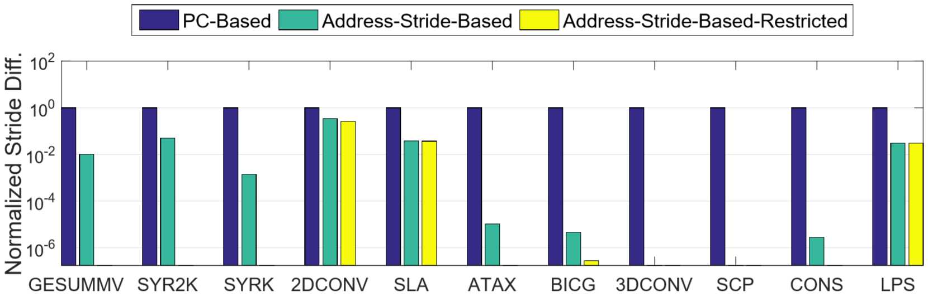
Track Address Strides for Better Value Prediction (2)
Request order
enforced by:
Only accepting constant address strides
Only accepting address stride = 1 or address stride = row size
No enforcement
Error Indicator
(lower the better)
Using address stride improves the predictability of values.
Notes:
We prefer lower stride differences as constant value strides indicates good predictability.

Slide 12
Outline
Background & Motivation
Design of ASAP
Evaluation
Conclusion

Slide 13
Challenges of ASAP
How to efficiently track address strides?
How do we handle irregular memory access patterns?
How do we ensure the design of the value predictor is area-efficient?

Slide 14
Address Stride Assisted Approximate Load Value Predictor (ASAP)
Sub-predictor 1
Sub-predictor 2
Address
Stride Short
Address Stride Long
Value Stride Short1
Value Stride Long1
Value Stride Short2
Value Stride Long2
Address Base
Value Base0
Value Base16
Entries with
LRU Eviction
2
1
2
4
2
4
8
2
4
....
....
MUX
MUX
match
match
word 0-15
word 16-31
Upcoming
Address = 3
Upcoming
Address = 4
Value = 6
Value = 10
Value = 8
Value = 12

Slide 15
Walkthrough Example – Effectiveness of ASAP over Prior Work

Slide 16





Operation of RFVP (Prior GPU Value Predictor)
Address Sequence: 0 → 1 → 2 → 4 → 3 → 5
$$val$$
0
2
4
8
6
10
$$addr$$
$$val$$
Value
Value
Base
Stride
Training
0
0
0
--
1
2
2
2
Coverage = 4 / 6
Accurate Predictions = 2 / 4
Prediction
2
4
✓
4
2
4
8
$$✗$$
6
2
3
6
$$✗$$
8
2
5
10
✓
10
2

Slide 17



Operation and Advantage of our new ASAP Predictor
Address Sequence: 0 → 1 → 2 → 4 → 3 → 5
$$val$$
0
2
4
8
6
10
ASAP:
Coverage = 3 / 6
Accurate Predictions = 3 / 3
Address
Address
Address
Value
Value
Stride
Stride
Value
Stride
Stride
Base
Short
Long
$$addr$$
$$val$$
Base
Long
Short
Training
0
0
--
--
0
0
--
--
1
1
--
1
2
2
2
--
RFVP
Coverage = 4 / 6
Accurate Predictions = 2 / 4
Prediction
✓
2
1
2
2
4
4
2
4
4
1
2
4
8
✓
8
2
4
Not Applicable
3
6
No Prediction
5
10
✓
2
5
1
2
10
4

Slide 18
Outline
Background & Motivation
Design of ASAP
Evaluation
Conclusion

Slide 19
Evaluation Methodology
Evaluated using GPGPU-Sim
  A cycle-level GPU simulator
Baseline Configuration (More details in the paper)
  30 SMs, 32-SIMT Lanes, 32 Threads/Warp, 48 Warps/SM
  16KB L1 (4-way, 128B Cache Block) + 32KB Shared Memory per SM
  256KB L2 (8-way, 128B Cache Block) per Memory Partition
  6 GDDR5 Memory Partitions, 16 Banks/Partition
  1 Crossbar/Direction
Workloads -- 12 Applications
  From CUDA SDK, Polybench
  Divided into different groups based on their characteristics

Slide 20
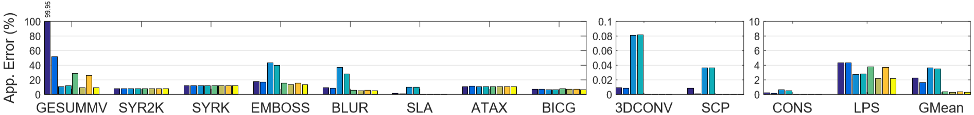
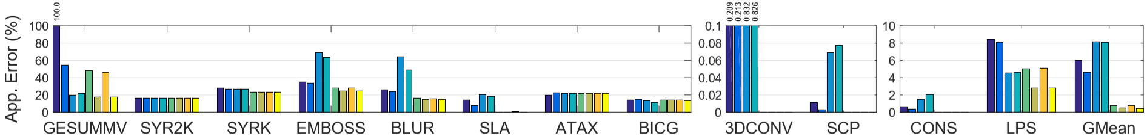
Application Error
10% Coverage:
20% Coverage:
ASAP achieves better prediction accuracy with low entry requirement .
ASAP leads to more improvements at higher prediction coverages.
Notes:
The error increase from 10% to 20% coverage is much higher in RFVP predictors than in ASAP predictors.

Slide 21
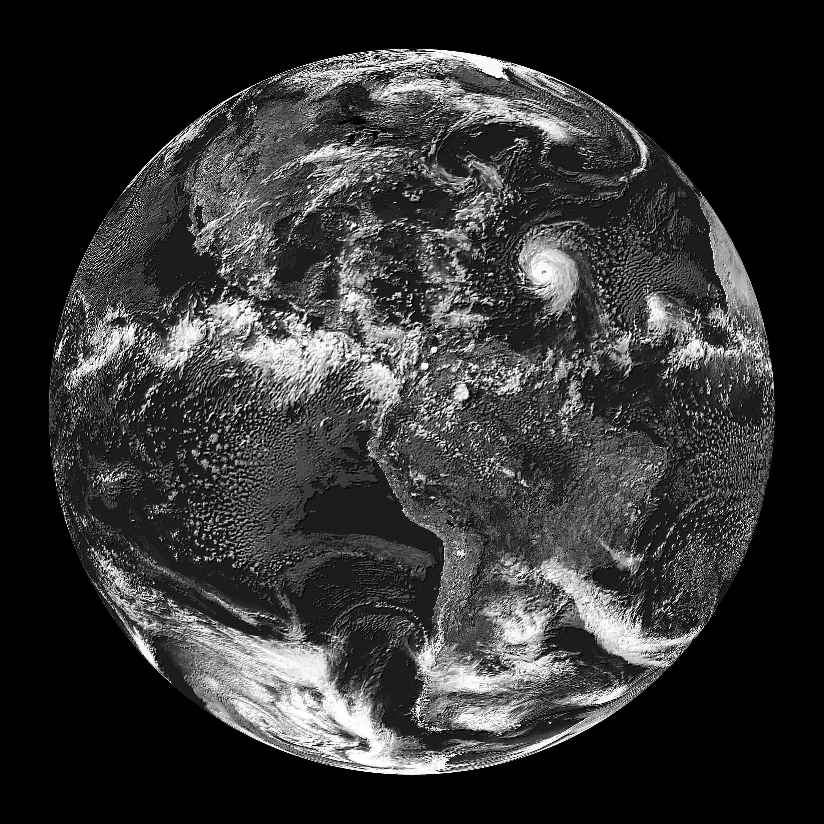
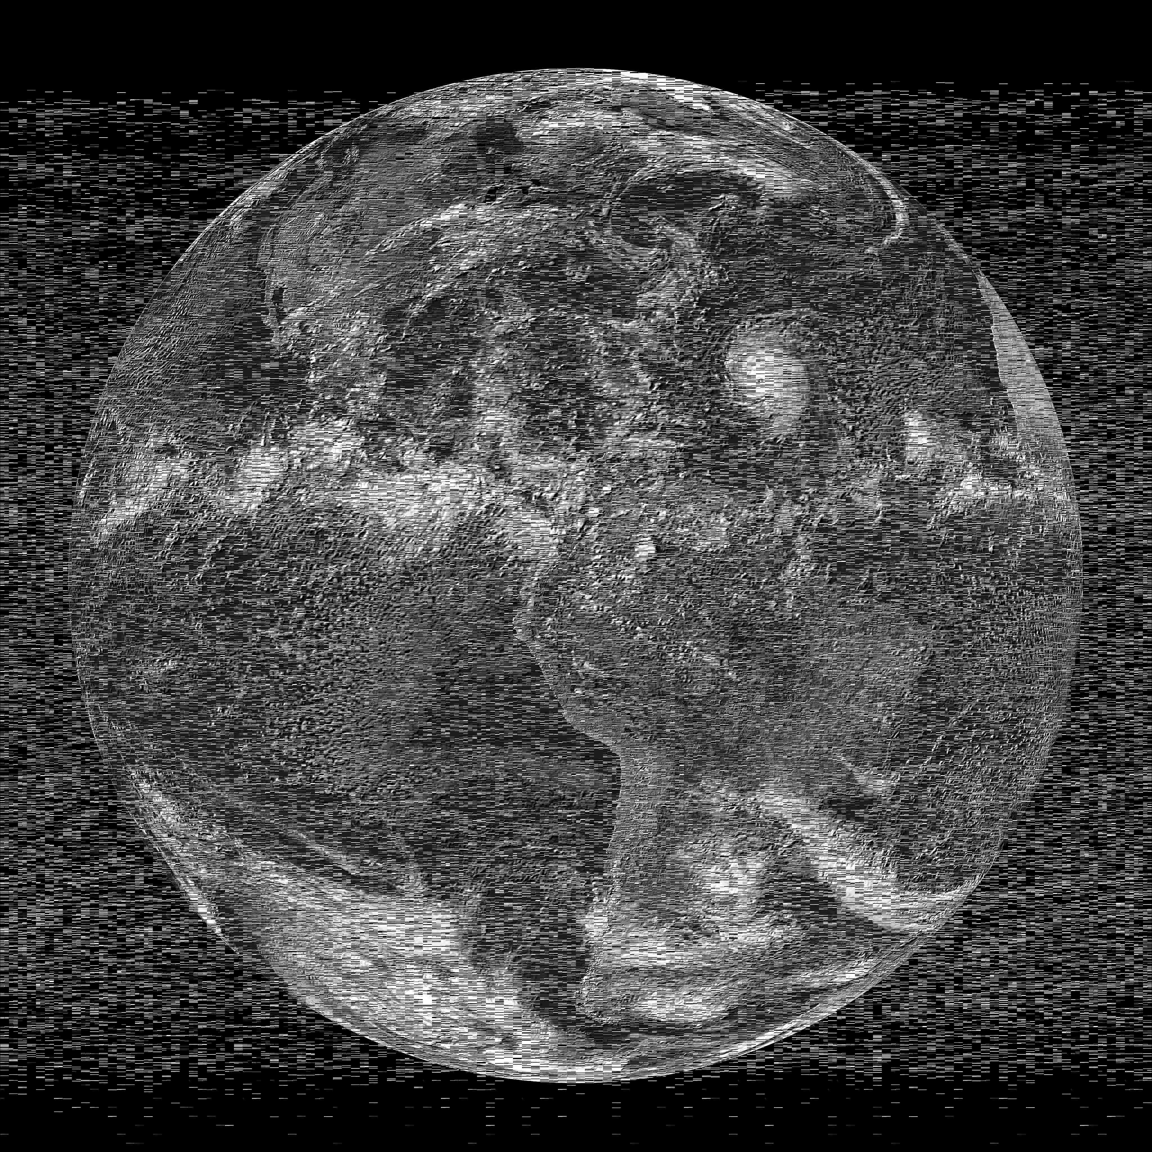
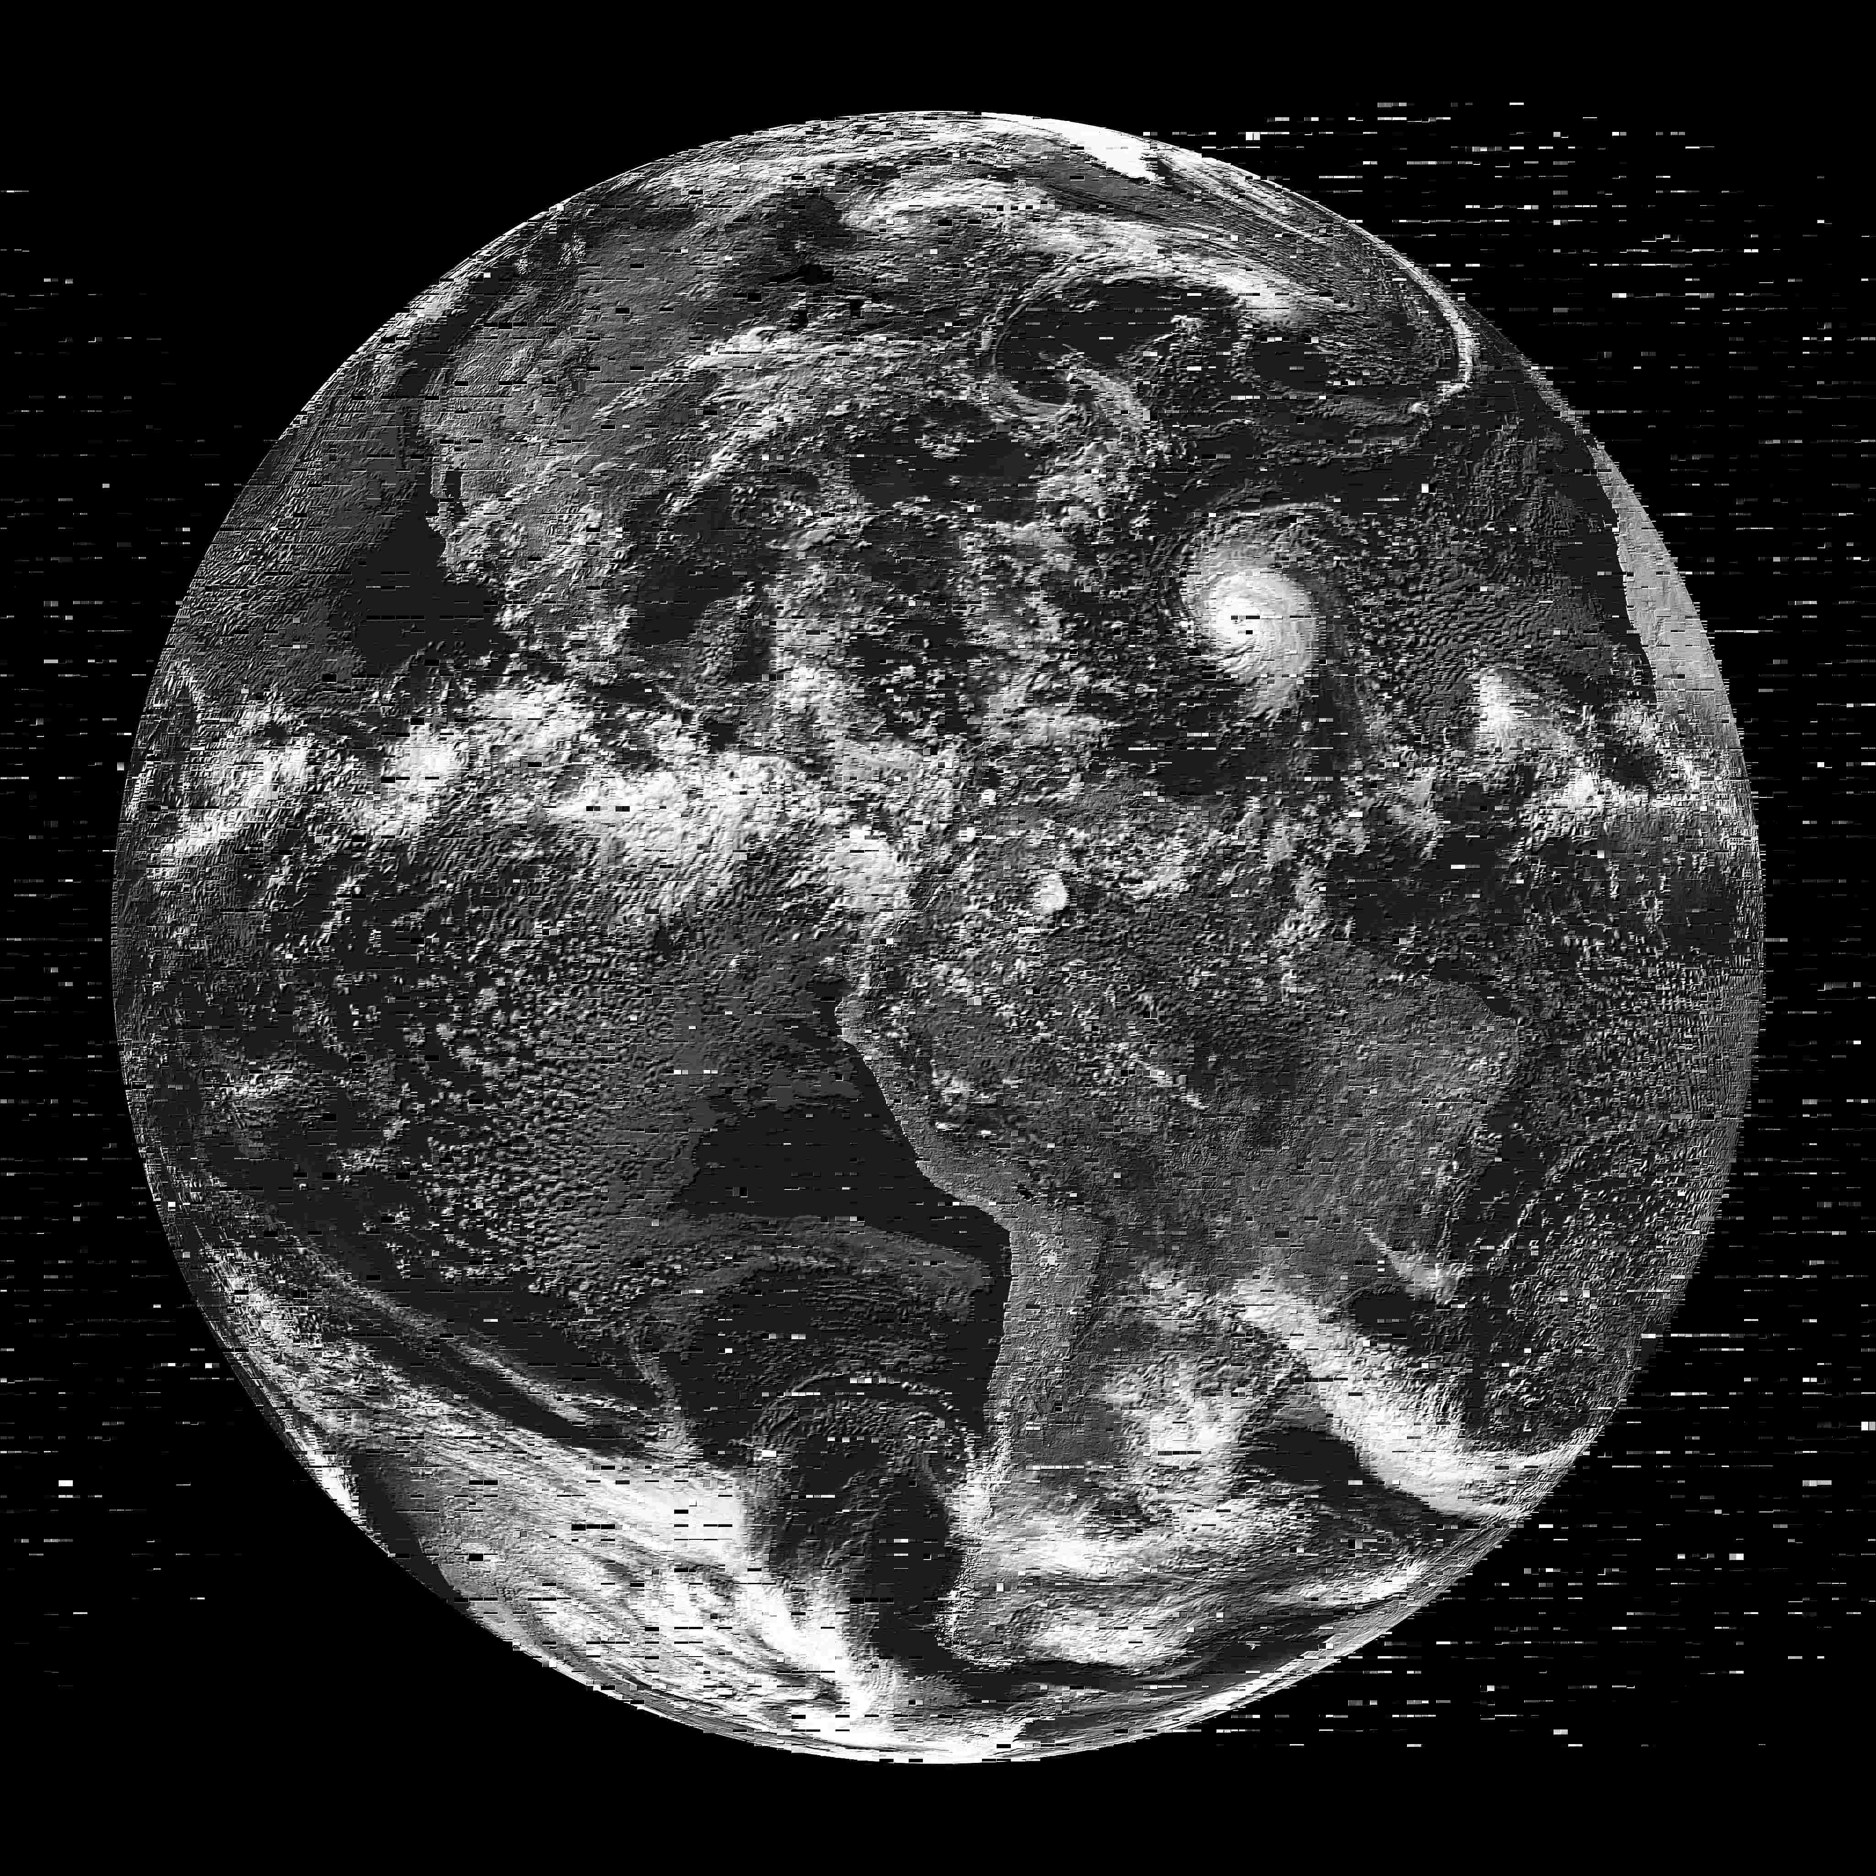
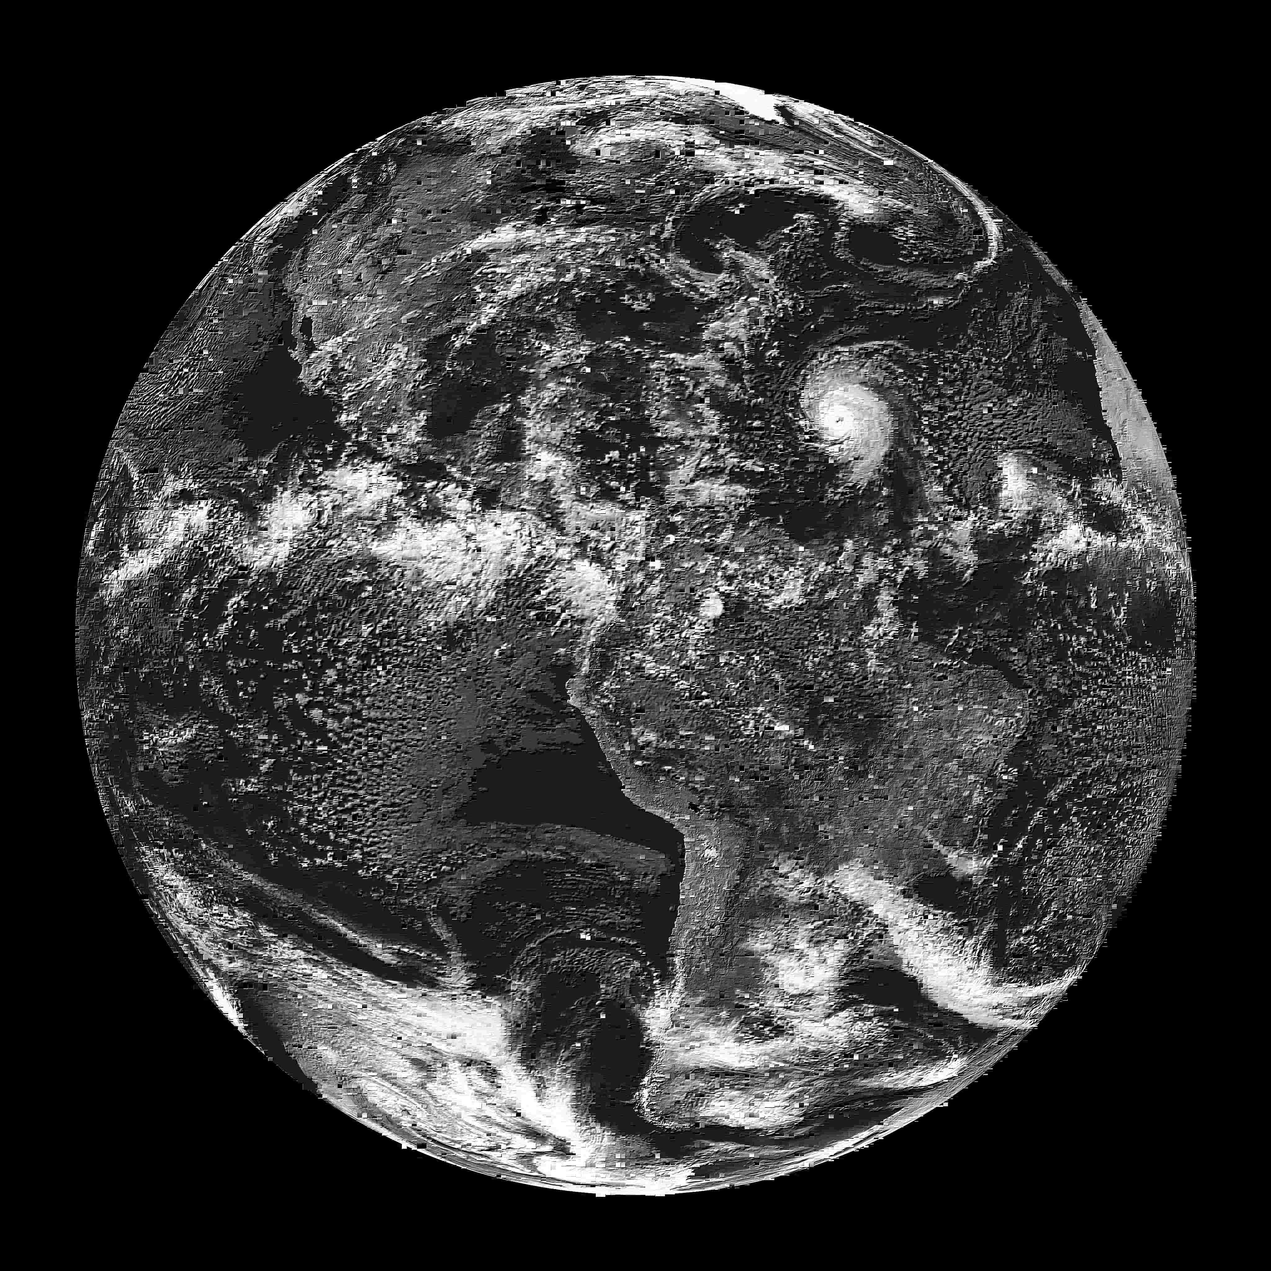
Image Quality at 10% Coverage
No Prediction
App. Error: 0%
RFVP-TSP-8
App. Error: 40.1%
RFVP-TSP-Unlimited
App. Error: 16.9%
ASAP-TSP-8
App. Error: 13.6%
Utilizing address stride & value stride correlation for value approximation is effective in improving the output quality.

Slide 22
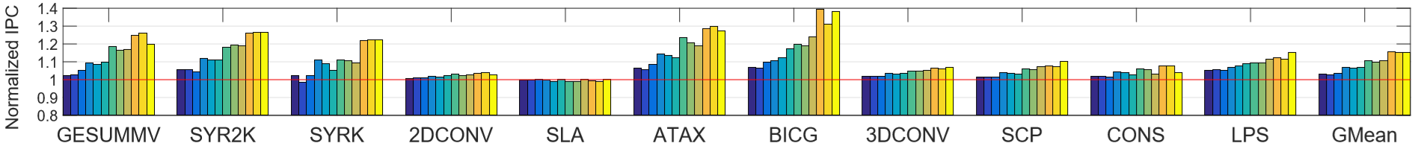
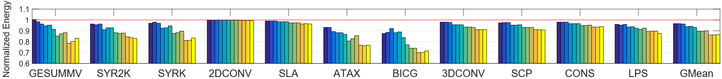
IPC & Energy
ASAP achieves:
Similar performance and energy improvements with less application error.
More performance and energy improvements with same application error budget.

Slide 23
Conclusions
Goal: Design low overhead, more accurate value approximation technique for GPUs.
Contributions:
  Demonstrate the correlation between address stride and value stride.
  Design a novel value approximation technique for GPUs (ASAP):
  Low capacity requirement
  Adaptive to complex access patterns in GPUs
  Across a variety of GPGPU applications, ASAP reduces application error by 84% to 95% in different scenarios.

Slide 24
Thank You!
Questions?
We acknowledge the support of the National Science Foundation (NSF) grants (#1657336, #1717532 and #1750667)
and Science & Engineering Research Board(SERB) award (#ECR/2017/000622)

Slide 25
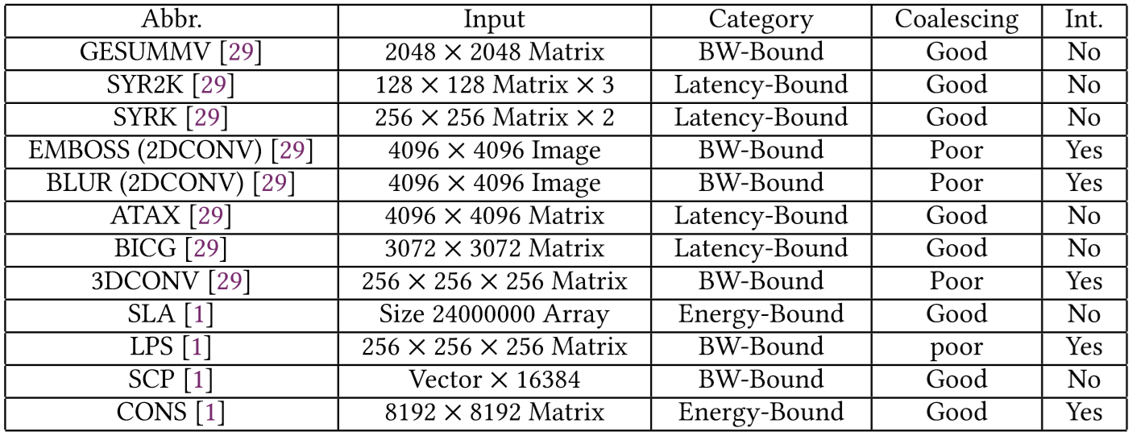
Application Characterization

Slide 26
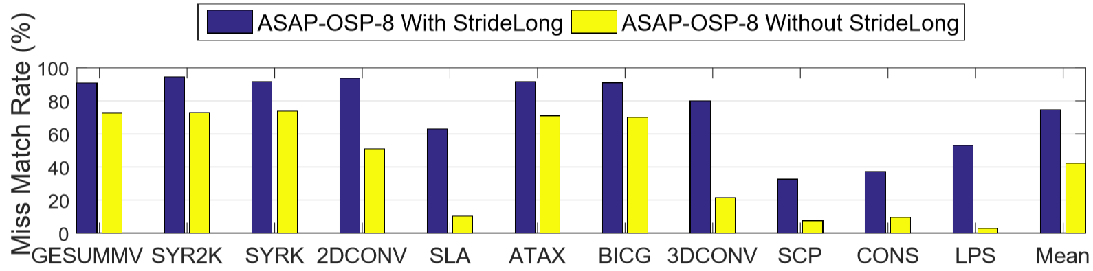
Case Study: Effective of Address Stride Long
  Miss Match Rate: The maximum percentage of missed requests that can be matched with ASAP.
Address stride long effectively improves the miss match rate.
  Miss Match Rate: The maximum percentage of missed requests that can be matched with ASAP.

Slide 27
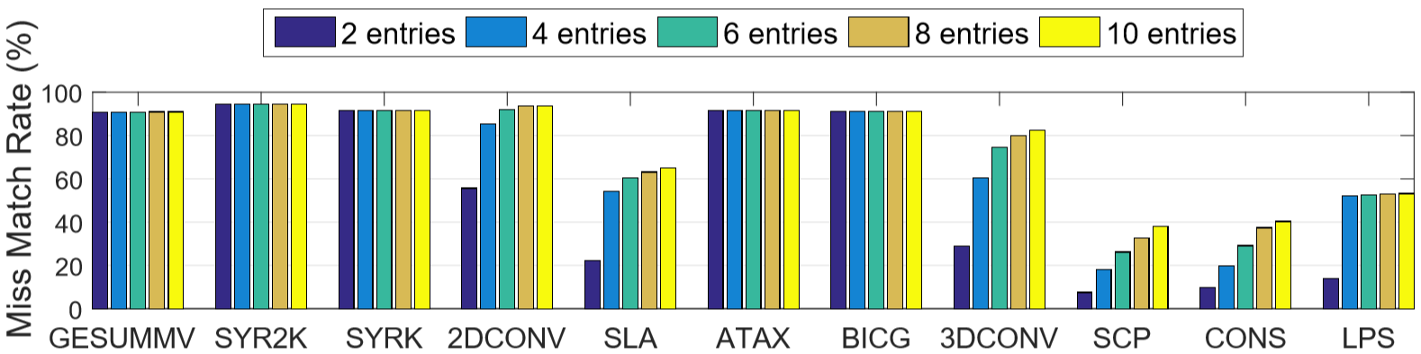
Case Study: Effect of Number of Entries
  Generally, 8 entries can provide enough Miss Match Rate for ASAP.
  The prediction table size requirement for ASAP is limited.
  Miss Match Rate: The maximum percentage of missed requests that can be matched with ASAP.

Slide 28
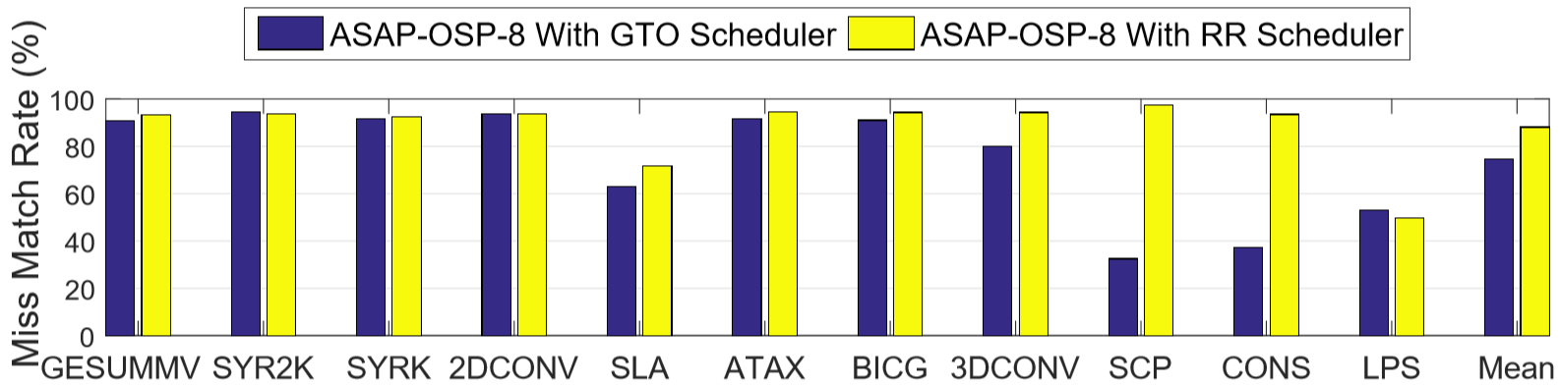
Case Study: Effect of Warp Scheduler
Miss Match Rate increases with more a regular scheduling scheme.
  Miss Match Rate: The maximum percentage of missed requests that can be matched with ASAP.

Slide 29
CPUs: Prior Value Prediction Works
Context based predictor:
Use context table (containing history PCs) to index into prediction table
Hash function based predictor:
Use instruction info (e.g., PCs) to index into prediction table
Not optimized for GPUs:
Use per-thread large prediction table – expensive for multi-threading
Does not directly consider the memory access order
Does not handle memory divergence
CPU
GPU
Multi-threading
Limited
Highly multi-threaded
Instruction Order
Limited out-of-order
Determined by warp scheduler
Memory Divergence
Limited
Yes
Notes:
Roll back is more expensive in GPUs.

Slide 30
Compiler Assisted Code Annotation
Annotated CUDA code:
Generated PTX code:
#pragma add_pred{fetch, 9, predict , 1}
...
#pragma approx{B}
C[i] = A[i] + B[i];
.fetch 9
.predict 1
...
ld.global.u32.approx %r0, [%r1]

